Slide 1

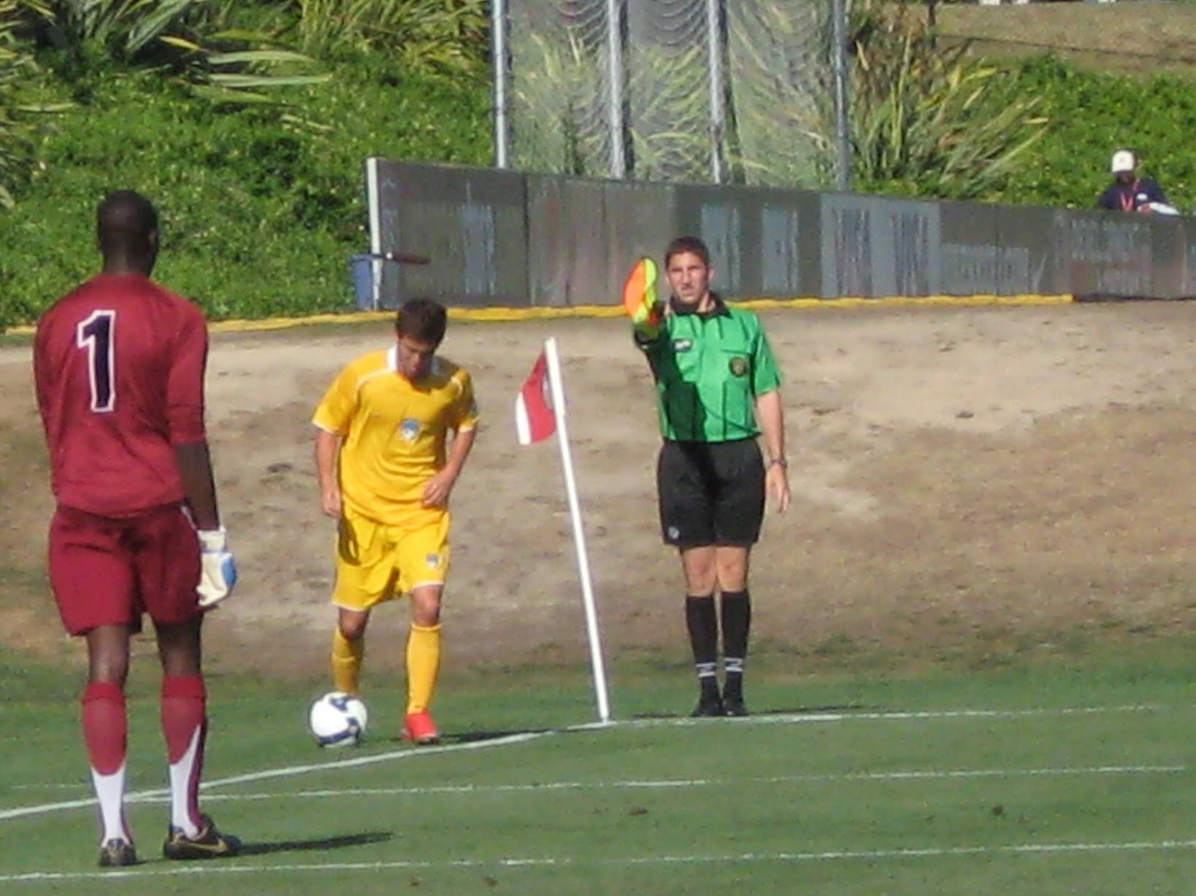

Law 6
The Assistant Referee
2017

Slide 2
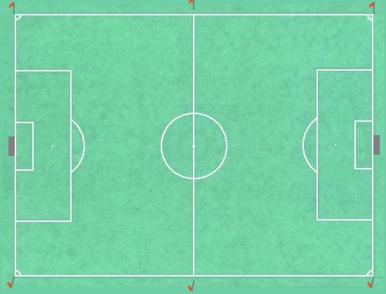
Mechanics
Spectator side
AR 2
Standard Diagonal
AR 1
Team side
Notes:
This diagram shows the standard diagonal for the referee. It also shows the 2 patrol paths for the AR’s.
If the referee elects to use a reverse diagonal, The AR’s would simply change which end of the field they patrol.

Slide 3
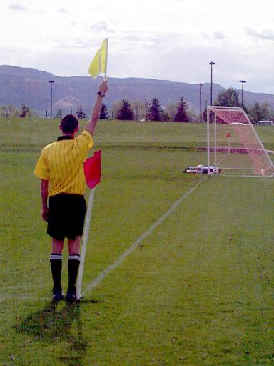
AR Positioning
It is important for the Assistant Referee to be in the correct position.
Notes:
In this picture, the AR is signaling the ball had crossed the goal line. When the referee acknowledges the signal, the AR would then turn and sprint up the touchline 10—20 yards to indicate in his opinion a goal was scored.

Slide 4
AR Positioning
Positioning
  Off the field, along the touch line
  One-half of the field only
  Even with second-to-last defender - or- even with ball, whichever is closer to the goal line
  Follow all balls to goal line
Signals
  Must know instantly and use properly
Notes:
Where are AR’s positioned?
Along the touchline in half the field, even with the 2nd to last defender or the ball, whichever is closer to the goal line.
AR’s like the Referee need fitness for proper positioning.
Signals, AR’s must know instantly and use properly always.

Slide 5
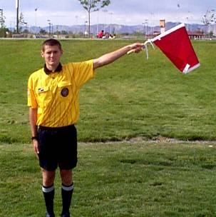
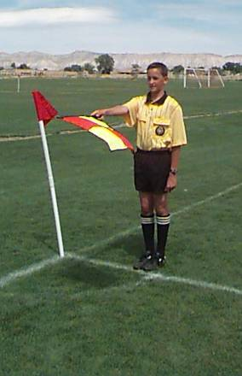
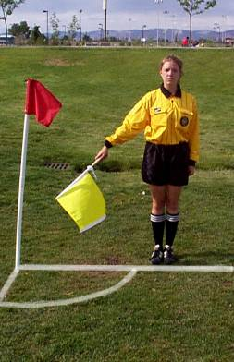
Assistant Referee Signals
Throw-in
Corner kick
Goal kick
Notes:
All AR signals should be given after stopping and looking at the referee while at attention position.
Here is a throw-in. Arm held at about 45 degrees up pointing with the flag in the direction of the throw-in.
A Goal kick, standing with flag in one arm held out parallel to the ground pointing toward the goal area.
The Corner Kick. While far enough away from the corner flag to not cross it with your flag, your arm and flag pointing down at 45 degrees toward the corner flag, regardless of which side the kick should be taken from.

Slide 6
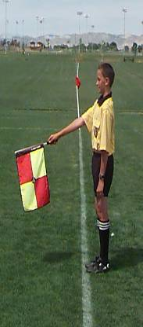
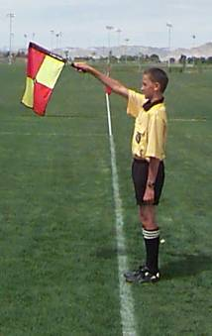
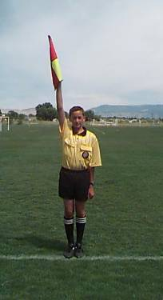
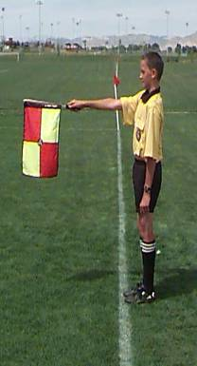
Assistant Referee Signals
Offside - Far side
Offside - Near side
Offside or Stop play
Offside - Center
After Referee stops play …..
Notes:
Here is the Offside signals.
First the flag straight up in one arm until recognized by the referee’s whistle. Upon the whistle indicate which 1/3 of the field away from you the offense and restart should be in. Far side, mid-field, or near-side.

Slide 7
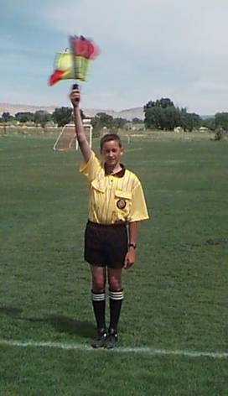
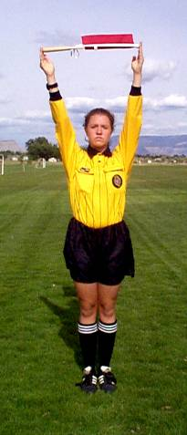
Assistant Referee Signals
Foul - Flick or wave flag
Substitution requested
Notes:
Remember, the foul is a raised flag, then after the whistle a slight waggle, then the direction of the restart.
A substitution is the flag held overhead between both arms in the open palms of the hands. Once the referee acknowledges the signal, bring it down.

Slide 8
AR Involvement
AR’s should ALWAYS first LOOK for,
or at, the Referee
before using flag
Notes:
Here’s the first thing we want you to learn. AR’s should always first look for, or at, the referee before using flag.

Slide 9
Communication
Whenever the ball is out of play, the referee and the assistant referees have the opportunity to exchange information
LOOK LOOK LOOK
Notes:
Whenever the ball is out of play, this is a chance for the Referee and AR’s to exchange information. It is also an opportunity to lend support and ensure everyone’s on the same page.

Slide 10
Communication
Good communication is essential
Eye contact at every opportunity
Verbal contact only as necessary
The AR provides information and the referee makes the final decisions
Notes:
For Assistant referees, good communication is essential. Since AR’s don’t have a whistle, they must learn to use all their other tools. Like making eye contact at every opportunity with the Referee. Use verbal communication only as necessary. The AR’s provide information and the referee makes the decisions.

Slide 11
Relationship with Referee
Law 5: “The referee controls the match in co-operation with the assistant referees…”
The referee is the “boss”
An assistant referee who isn’t doing their job may be dismissed
Assistant referees do just that… they assist the referee - they do not insist
Notes:
The work and responsibilities of the referee depend on the support and assistance of the Assistant Referees. The laws state that the referee controls the match in cooperation with the assistant referees.
In law 6 it states that “two assistant referee are appointed whose duties, subject to the decision of the referee…
So AR’s must always accept the fact that while they are part of the team, the final authority rest with the referee.

Slide 12
Assistance In Game Control
Flag up for serious misconduct
Give opinions on points of fact when requested by the referee
  What you saw
  What you heard
  Be specific - not vague
Notes:
For serious misconduct, raise the flag. When the referee comes over, give the referee what you saw or heard and be specific on which player was involved.

Slide 13
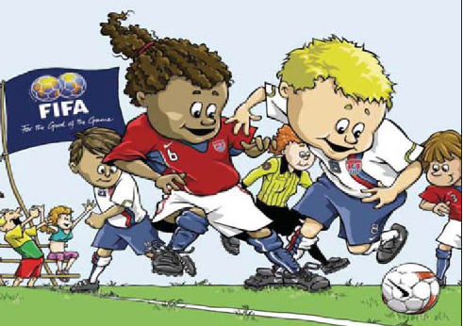
Review of the Test and Laws 5 & 6

Slide 14
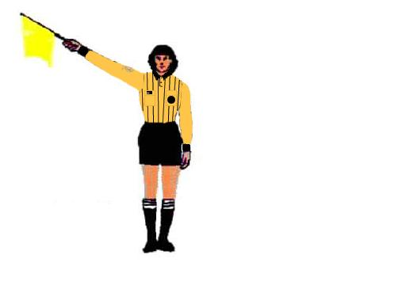
LAWS 5 & 6
The ball completely crosses over the touch line, between the halfway line and an assistant referee (AR). The AR should signal with the flag at 45 degrees above the horizontal in the direction of the throw-in.
A. True B. False

Slide 15
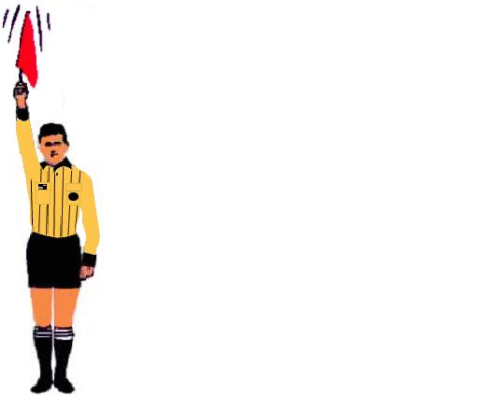
LAWS 5 & 6
39. The referee notices that you have raised the flag vertically and have given it a slight wave. The referee concludes that you are indicating an offside violation.
A. True B. False

Slide 16
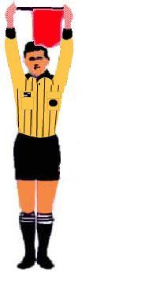
LAWS 5 & 6
The AR indicates to the referee that a substitution is requested by using the following signal. How long should the AR maintain this signal?
A. Until the substitution process is completed
B. Until the referee waves the substitute onto the field
C. Until the referee acknowledges the signal and
delays the restart of play
D. Until the player being subbed out begins running
off the field
. False

Slide 17
LAWS 5 & 6
The person who is required to keep a record of the game, according to Law 5, is the:
A. senior AR B. referee C. league or field administrator.

Slide 18
LAWS 5 & 6
While play is going on in his half of the field, the AR’s main position is in line with the second-to-last defender or the ball, whichever is nearer to the goal line.
A. True B. False

Slide 19
LAWS 5 & 6
According to Law 5, the referee should stop the game if, in her opinion, a player is seriously injured.
A. True B. False

Slide 20
LAWS 5 & 6
The process of inspecting player equipment does not have to take place if the game is running behind schedule.
A. True B. False

Slide 21
LAWS 5 & 6
Midway through the second half, you see lightning in the distance. The coaches of both teams wish to continue the game. As the referee, you should
A. allow the game to continue, since the
lightning was not nearby.
B. suspend the game, regardless of the
coaches’ opinions, and find shelter
immediately

