Slide 1
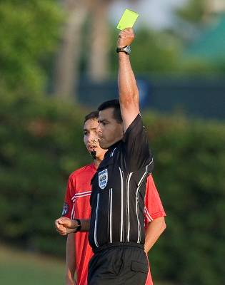
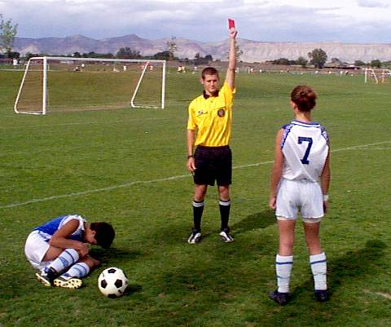
Free Kick Management
2017

Slide 2
Free Kick and Restart Management
Free Kicks fall into two basic restart categories…
Quick
Ceremonial
Notes:
Basic Requirements for Managing Free Kicks
If at all possible, the referee should know the tendencies of the teams and the individual players before the game so he can facilitate their style.
There are two types of free kicks with separate methods for managing each: Quick Free Kicks (QFK) and Ceremonial Free Kicks (CFK).

Slide 3
Free Kick and Restart Management
Quick Free Kick
Attacking team takes kick as soon as ball is properly placed
No separate signal by referee needed
Attacking team does not ask for minimum
distance (visually or verbally)
Should be the method encouraged by the referee except when specific circumstances require a Ceremonial Free Kick
Notes:
Quick Free Kicks (QFK)
Definition:
The attacking team takes the kick as soon as the ball is properly placed, with no separate signal needed by the referee. The attacking team does not ask for (verbally or visually) the minimum distance to be enforced.
Should be the method encouraged by the referee except where a specific reason exists requiring a Ceremonial Free Kick (CFK).

Slide 4
Free Kick and Restart Management
Ceremonial Free Kick
Referee is required to enforce the distance after:
Red/Yellow card
On field treatment of injury
Substitution
Request from attacking team (visually or verbally)
Game control purposes
Notes:
Ceremonial Free Kicks (CFK)
Definition: The kick cannot be taken by the attacking team until the referee gives a separate signal – the whistle - under the following circumstances:
The attacking team requests a CFK by asking the referee (verbally or visually) for the minimum distance to be enforced or “to move the wall back.”
The referee chooses to enforce the distance for game management purposes.
CFK should be used only when:
A red or yellow card is to be given for misconduct occurring prior to the restart.
A serious injury occurred requiring the trainer to enter the field to attend to but not treat the player (or on the field treatment of an injured goalkeeper)
Substitution
The attacking team requests that the minimum distance requirement be enforced against the opponents.
Game Control Purposes: (some examples)
- Calm the situation down
- Managing the players
- Substitution

Slide 5
Free Kick and Restart Management
To Avoid Problems - Set the Tone
Address early
Prevent
Set a standard
Hold players accountable
Failure to deal with early
Difficult times later
=
Notes:
Set the tone on Free Kick restarts
It is critical to set the tone early on all free kick restarts. Set your standards and then hold the players accountable – set the precedent. Failing to deal with encroachment and interference early, makes it more difficult to get distance in the critical areas of the field as the game develops. Where encroachment or interference is blatant and obvious, your control is being tested and it is particularly important that you act firmly. Where it is less obvious, use discretion but be consistent.

Slide 6
Free Kick and Restart Management
Sequence of Actions to Manage Free Kicks
Quick Free Kick
Ceremonial Free Kick
Whistle Foul
Move Toward Spot of Foul (as needed)
Ensure Ball Properly Located
Read Player’s Intent: Move to Position Appropriate for the Restart
Look for Confirmation of
Ceremonial Kick (CFK)
From Attackers
Encourage the Kick by Verbally Managing Opponents Around the Ball to Prevent Interference
Team Indicates They Want Ceremonial Restart (CFK)
Get To Ball
Show “Wait for Whistle Signal”
Move the Wall Back: Get 10 yards From Players in All Directions
Move to Restart Position
Whistle for Restart
Notes:
Sequence of Actions to Manage Free Kicks
As much as possible, referees should attempt to follow the Sequence of Actions described on this chart.
The major PREVENTATIVE items are highlighted in RED.
Keys:
Reading intent (of both the attacking and defending teams) and getting to ball if there are “signs” of interference or possible delay by opponents.
Encourage, with presence and verbal management, players to move from the ball and toward a reasonable distance so that a QFK can be taken.
If a CFK is to be given, the referee MUST get 10 yards in ALL directions.

Slide 7
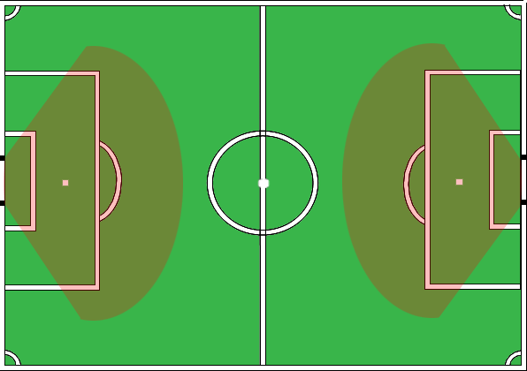
Free Kick and Restart Management
Danger Zone on Free Kicks
Ball at proper location
Referee close but not
interfering with a
“quick free kick”
Ask/ascertain if the attacking team wants the wall moved
If so, move quickly to the ball
Clearly indicate “wait for the whistle” signal
Move wall back: Get the full 10 yards!
Whistle restart
Notes:
Danger Zone Free Kicks
“Danger zone” refers to the area approximately 18-35 yards from goal in which goals can be scored directly off the restart
Key points in managing Danger Zone Free Kicks:
Ball at proper location
Referee close but not interfering with a “quick free kick:” is the attacker looking to put the ball into play (body language)?
Ask or ascertain through body language and players’ actions, if the attacking team wants the wall moved
If the attacking team indicates they want a ceremonial free kick, the referee must move quickly to the ball
Clearly indicate “wait for the whistle” signal by visually pointing to the whistle directly between the player’s eye level and the referee’s eye level and, as appropriate, verbally advising the attacking players in the vicinity to wait for the whistle: this will make it easier for the defenders to move into the proper position
Move wall back: defending players 10 yards away from the ball in all directions
Whistle the restart

Slide 8
Free Kick and Restart Management
The “Statue”
The player(s) who immediately stands in front of the ball to prevent the kick from being taken thereby forcing the referee to intervene
Deal with it verbally
Encourage the statue to move back
Detect trend
Move to the spot of the foul QUICKLY
Your presence is IMPORTANT
Consider:
Did the player run-in to form the statue or were they
already there immediately following the foul?
Notes:
The “Statue”
Definition: The player(s) who immediately stands in front of the ball to prevent the kick from being taken thereby forcing the referee to intervene.
Proactive verbally: As you see the player take position in front of the ball, verbally ask them to retreat
Encourage the statue to move back with you: As you move to the restart position, attempt to encourage the statue to move with you / back-up with you
Detect trend: If you see this as a trend to delay the restart, move to the spot of the foul quicker and manage more with your presence
Consider: did the player run-in to form the statue or was he there immediately following the foul?

Slide 9
Free Kick and Restart Management
The “Statue”
Your Presence is critical
to prevent “the statue” from
kicking or throwing the ball away
Presence = Prevention
Without Presence…Cautions may result
Delaying a Restart
Not Respecting the Required Distance
Notes:
The “Statue”
The key is prevention through presence. Without prevention, defenders will engage in tactics that will result in them receiving a yellow card like:
Delaying the restart
Not respecting the required distance

Slide 10
Free Kick and Restart Management
Cautions and Retakes
“If a player decides to take a free kick and an opponent who is less that 10 yards from the ball intercepts it, the referee must allow play to continue.”
and
“If a player decides to take a free kick quickly and an opponent who is near the ball deliberately prevents him from taking the kick, the referee must caution the player for delaying the restart of play.”
Notes:
Cautions and Retakes
Referees are responsible for ensuring that free kicks are taken without encumbrances unless a team decides to take a quick free kick. The following guidelines must be followed as they relate to the taking of a free kick.
Note the following new sentences contained in the 2008/2009 version of FIFA’s “Interpretation of the Laws of the Game and Guidelines for Referees:”
“If a player decides to take a free kick and an opponent who is less that 10 yards from the ball intercepts it, the referee must allow play to continue.”
and
“If a player decides to take a free kick quickly and an opponent who is near the ball deliberately prevents him from taking the kick, the referee must caution the player for delaying the restart of play.”
These sentences are at the heart of the interpretation and directives that follow.

Slide 11
Free Kick and Restart Management
Cautions and Retakes
“If a player decides to take a free kick and an opponent who is less that 10 yards from the ball intercepts it, the referee must allow play to continue.”
and
“If a player decides to take a free kick quickly and an opponent who is near the ball deliberately prevents him from taking the kick, the referee must caution the player for delaying the restart of play.”
Key Phrase…..
Notes:
Cautions and Retakes
The key phrase here is “deliberately prevents.” This means that the player impedes in a manner that the kicker is unable to take the free kick quickly. If the kick is taken, it has not been prevented from being taken and, in most instances, play must be allowed to continue.

Slide 12
Free Kick and Restart Management
Cautions and Retakes
Key Phrase “deliberately prevents”
This means that the player impedes in a manner that the kicker is unable to take the free kick quickly.
If the kick is taken, it has not been prevented from being taken and play must be allowed to continue.
The taking of the free kick is a decision of the attacker and, therefore, the attacker must assume responsibility for the consequences
Notes:
KEY:
The taking of the free kick is a decision of the attacker and, therefore, the attacker must assume responsibility for the consequences.

Slide 13
Quick Free Kick
Kicking team has a right to a quick restart if they wish to use it
Opponents must retire 10 yards
Opponents have no right to form a wall
Kicker restarting prior to the opponents retiring is at risk of losing possession
Notes:
Quick free kicks.
Remember, The kicking team has a right to a quick restart if they wish to use it.
At the same time, opponents must retire 10 yards and have to right to form a wall.
Should the kicker restart prior to the opponents retiring then the kicker risks losing possession.

Slide 14
Quick Free Kick
Referee should interfere/manage when:
Kicking team asks for 10 yards
Encroachment is severe
“Quick” restart is not taken
Mandatory hand signal on IFK
Notes:
The referee should intervene to manage the restart when;
The kicking team asks for the 10 yards
The encroachment is so severe that the kick can’t be taken.
The quick restart is not taken, this is when the referee must have a “feel” for when to intervene.
If the restart is an IFK, the arm up signal is mandatory. If the kick is taken and the are was not in the air, then if it goes into the goal the kick must be retaken.
On the other hand, if the kick is taken and it does not go into the goal, then the restart is whatever is required because the attacking team had it’s chance.
[Reference – Additional Instructions and Direction to Referees in the back of the FIFA Laws of the Game]
[Q1 – Retake Kick]
[Q2 – Play continues]

Slide 15
Quick Free Kick Guidelines
Opponent retiring and kicker makes mistake and kicks ball to opponent
No offense - kicker at risk
Opponent retiring, but deflects ball when kicked right by him/her
Warn player - retake kick if no goal results
Opponent retiring, but makes an effort to intercept the ball. If they succeed,
Caution and then retake kick
Notes:
Here are some scenarios for quick free kicks and how the referee should manage each.
The opponents are retiring and the kicker makes a mistake, kicking the ball to the opponents. In this case no offense, the kicker was at risk.
The opponents are retiring, but deflects the ball when it is kicked right by him/her. Here it is recommended the referee warn the player and retake the kick if no goal resulted.
The opponents are retiring, but make an effort to intercept by moving toward the ball. Should the player succeed, stop play, caution the player and retake the kick.

Slide 16
Quick Free Kick Guidelines
Attacking Team Deliberately Kicks The Ball Into Opponent
Defender does not advance/lunge directly toward the ball with the foot/leg to prevent the kick
=
Continue Play
Regardless of the position of the defending team, if the attacking team intentionally kicks/plays the ball directly into the opponent who is less than the required minimum distance from the ball, continue play.
Notes:
Quick Free Kick – Attacking Team Deliberately Kicks the Ball Into the Opponent
Regardless of the position of the defending team, the attacking teams intentionally kicks/plays the ball directly into the opponent who is less than the required minimum distance from the ball – the defender does not advance/lunge directly toward the ball with the foot/leg to prevent the kick: continue with play
KEY TERMS:
Lunges directly toward
Advances directly toward

Slide 17
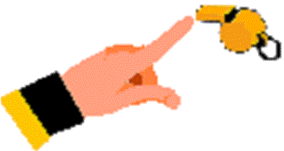
Ceremonial Free Kick
Organized “defensive wall”
Clearly show kicker to wait for whistle
Be “first brick” in the wall - 10 yards
Bring opponents to you
Move to your next position
Signal for restart
When you are ready
As soon as possible
Notes:
Some guidelines on sequence of managing a ceremonial free kick with an organized defensive wall,
1. Clearly show the kicker to wait for the whistle. (point at the whistle at eye level between the referee and the player)
2. BE the “first brick” in the wall without turning your back on the restart point and ball.
Bring the opponents to you.
Move to your next position, keeping the wall and the ball in sight at all times.
Signal for the restart when you are ready and as soon as possible. If you told them to wait for the whistle, then definitely use the whistle.

Slide 18
Encroachment
10 yards
in all
directions
Failure
to respect
the required
distance is
a cautionable
offense
Notes:
Encroachment and the required distance on free kicks must be enforced in all directions. While failure to respect the required distance is a cautionable offense, referees are expected to use all the preventive officiating techniques in their arsenal of player management tools to avoid the cards.

Slide 19
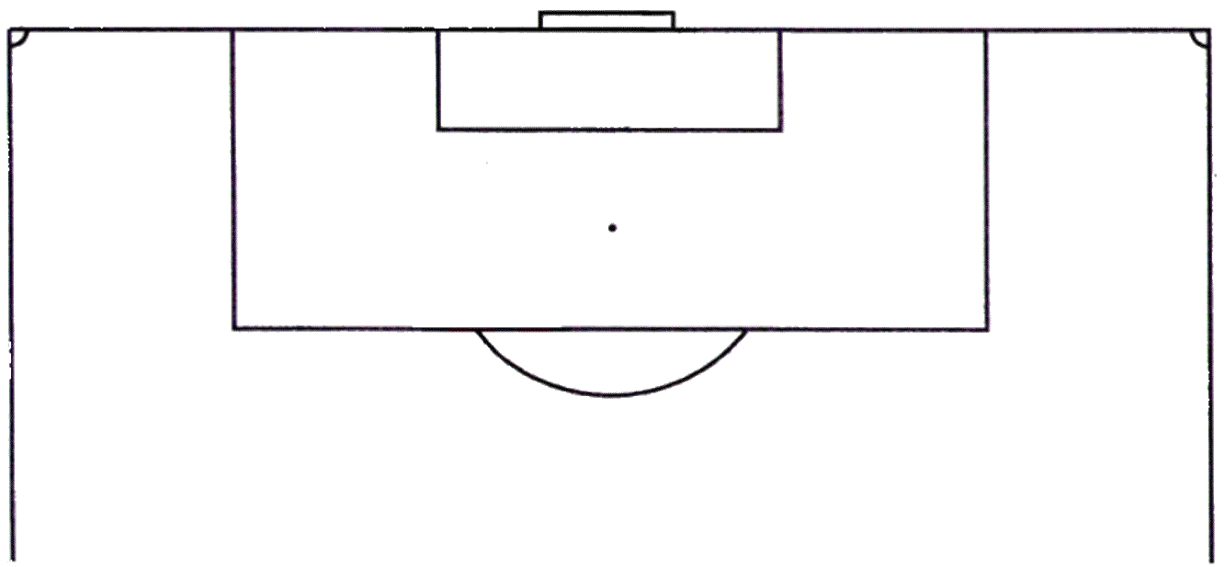
Restart Mechanics
Opponents must retire 10 yards with one exception,
if they’re between goalposts and on the goal line.
Notes:
Remember the exception we talked about, it’s 10 yards is all directions EXCEPT on the defenders own goal line between their upright posts.

Slide 20
Restart Mechanics
Position defenders
Do not allow encroachment
Position yourself
Indicate IFK if appropriate
Signal for restart
Use whistle if “ceremonial” kick
Notes:
To recap the sequence of your restart mechanics.
First position the defenders and don’t allow encroachment.
Position yourself to you can see everything as it develops in front of you.
Don’t forget to raise your arm to indicate IFK if that is the restart
Then signal for restart using a whistle if it’s ceremonial, because that’s what you told them to wait for.

Slide 21
Ball in Play vs Goal Scored
Ball is “in play” when:
Kicked and moves and
Leaves penalty area (if appropriate)
Goal can be scored when:
Ball is “in play”
Ball is touched by 2nd player on IFK
Ball is kicked into opponents goal
Notes:
The ball is in play when it is kicked and moves, plus if the free kick is inside the penalty area going out, it must leave the penalty area on the first touch.
A goal can be scored when the ball is properly put into play into opponent’s goal, and if it was an IFK after it was touched by a 2nd player from either side.

Slide 22
Misconduct Procedures
Procedure for issuing cards
For a Caution:
Isolate Offender (if necessary)
2. Book (Name, number, time, offense)
3. Display card
For a Send-off:
Isolate Offender (if necessary)
2. Display card
3. Keep your eyes on field and players
4. Book (Same info, but not until after player leaves)

