Slide 1
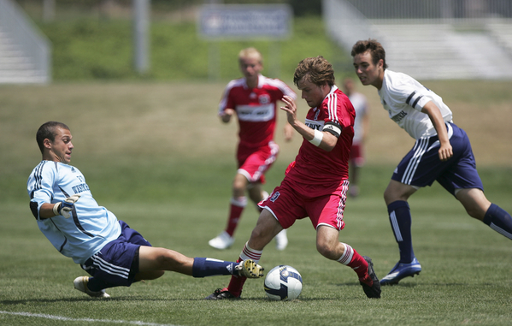

Law 12
Fouls and Misconduct
2017

Slide 2

FOULS – Definition
A foul is an infraction for which a Direct Free Kick (DFK) or an Indirect Free Kick (IFK) is awarded.

Slide 3
Foul Conditions
Remember - A foul may only occur
ONLY when…
When the ball is in play
When the ball is on the field of play
When the action is committed by a player…
Against an opponent who is also a player
The action is not a foul unless all 4 of these conditions are met.
Notes:
Lets start with a loose definition of a foul.
A foul may only occur when all three conditions or things are all present.
It must occur on the field play
The ball must be in play
The action is committed by a player against an opposing player or team.
If one of these is not present, it is not a foul per se. It may be misconduct or something else, but it’s not a foul.

Slide 4
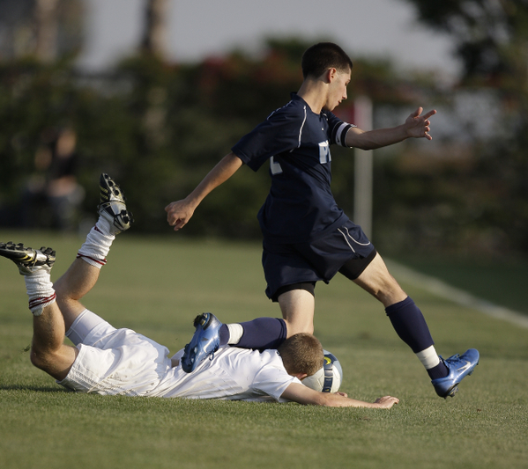
Law 12 – DFK Fouls
The 2 Types
of Fouls
DFK Fouls
IFK Fouls

Slide 5
Direct Free Kick Fouls – 10 Total
There are 10 Direct Free Kick fouls.
7 of these 10 DFK Fouls must be committed in a manner considered by the referee to be careless, reckless or using excessive force.
reckless
excessive
Notes:
Let’s look at the 10 direct free kick fouls. The first 7 must be recognized by the referee if they are committed in a manner the referee considers to be careless, reckless or using excessive force.
Kicks or attempts to kick an opponent.
Trips or attempts to trip an opponent.
Jumps at an opponent.

Slide 6
Definitions
Careless \ adj 1: unconcerned, indifferent 2: not showing care.
Force \ adj 1: strength or power exerted upon an object.
Reckless \ adj 1: lacking caution: rash syn: headlong, hasty.
Excessive \ adj 1: going beyond the usual, necessary, or proper limit or degree.
Notes:
More definitions you need to know for this lesson. These will be used as we describe different levels of fouls.
Careless
Reckless
Excessive Force are together when used in context, so their descriptions should be combined.

Slide 7
Direct Free Kick Fouls
7 DFK fouls result in a DFK if the referee decides it was done carelessly, recklessly or using excessive force. THEY ARE ….
recklessly
excessive
Pushing an opponent
Striking or attempts to strike an opponent
Charging an opponent
Jumping at an opponent
Kicking or attempts to kick an opponent
Tripping or attempts to trip an opponent
Tackling or Challenging an opponent

Slide 8
Direct Free Kick Fouls
What is careless….
Pushing?

Slide 9
Direct Free Kick Fouls
What is careless….
Pushing?
Striking (or attempting to strike) an opponent?

Slide 10
Direct Free Kick Fouls
What is careless….
Pushing?
Striking (or attempting to strike) an opponent?
Charging?

Slide 11
Direct Free Kick Fouls
What is careless….
Pushing?
Striking (or attempting to strike) an opponent?
Charging?
Jumping At?

Slide 12
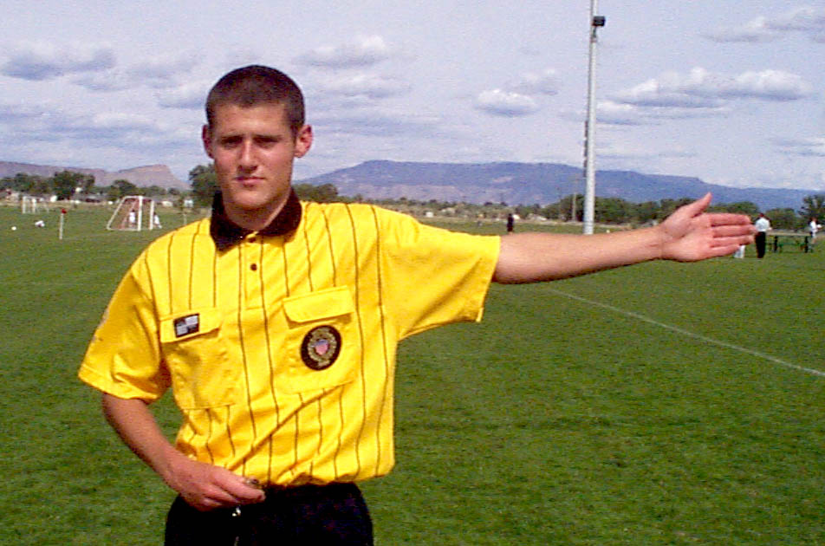
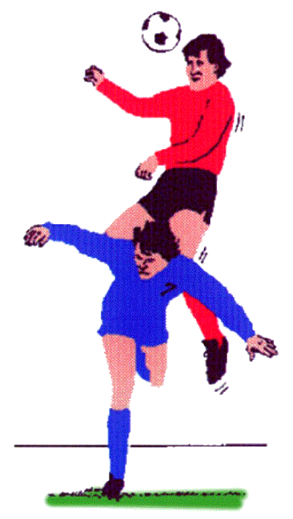
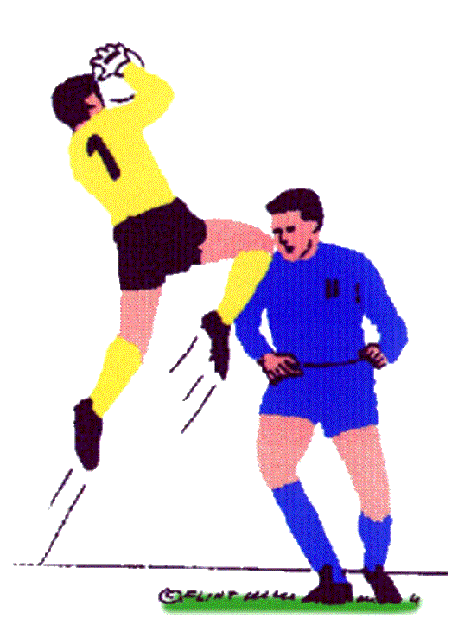
Direct Free Kick Fouls
Careless jumping at (into) an opponent
Notes:
Jumping into an opponent should be called after contact is made while a player leaves the ground with his/her body in an attempt to make contact with the ball, and the challenge is not made straight up, rather it goes into an opponent.

Slide 13
Direct Free Kick Fouls
Jumping
– watch out for –
Does jumper lead with arm, forearm or knee ?
Is the challenge UP, but not IN or UP and IN ?
Is the safety of the opponent endangered ?
What is the result of the contact ?

Slide 14
Direct Free Kick Fouls
What is careless….
Pushing?
Striking (or attempting to strike) an opponent?
Charging?
Jumping?
Kicking (or attempting to kick) an opponent?
Tripping (or attempting to trip) an opponent

Slide 15
Direct Free Kick Fouls
What is careless….
Pushing?
Striking (or attempting to strike) an opponent?
Charging?
Jumping?
Kicking (or attempting to kick) an opponent?
Tripping (or attempting to trip) an opponent
Tackling or Challenging an opponent ?

Slide 16
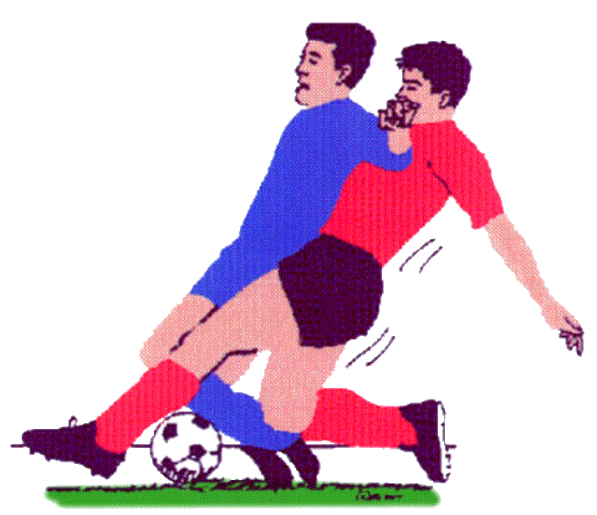
Direct Free Kick Fouls
A careless tackle or challenge of an opponent to gain possession of the ball, making contact with the opponent before touching the ball

Slide 17
Direct Free Kick Fouls – 10 Total
The remaining 3 DKF fouls do not require the player be Careless, Reckless or Excessive
A direct free kick is awarded to the opposing team if a player commits any of the following three offenses:
Holding an opponent
Spitting at an opponent
Handling the ball deliberately (except for the goalkeeper within his/her own penalty area)
Notes:
We’ve discussed the first 7 direct free kick fouls. Now lets look at the other 3. These three are not judged necessarily as done with careless, reckless, or with excessive force. Rather, if they happen, they happen.

Slide 18
Direct Free Kick Fouls
The remaining 3 DKF do not require the player be Careless, Reckless or Excessive
What is ….
Holding an opponent?
Notes:
We’ve discussed the first 7 direct free kick fouls. Now lets look at the other 3. These three are not judged necessarily as done with careless, reckless, or with excessive force. Rather, if they happen, they happen.

Slide 19
Direct Free Kick Fouls
The remaining 3 DKF do not require the player be Careless, Reckless or Excessive
What is ….
Holding an opponent?
Spitting at an opponent?
Notes:
We’ve discussed the first 7 direct free kick fouls. Now lets look at the other 3. These three are not judged necessarily as done with careless, reckless, or with excessive force. Rather, if they happen, they happen.

Slide 20
Direct Free Kick Fouls
The remaining 3 DKF do not require the player be Careless, Reckless or Excessive
What is ….
Holding an opponent?
Spitting at an opponent?
Handling the ball deliberately?
Notes:
We’ve discussed the first 7 direct free kick fouls. Now lets look at the other 3. These three are not judged necessarily as done with careless, reckless, or with excessive force. Rather, if they happen, they happen.

Slide 21
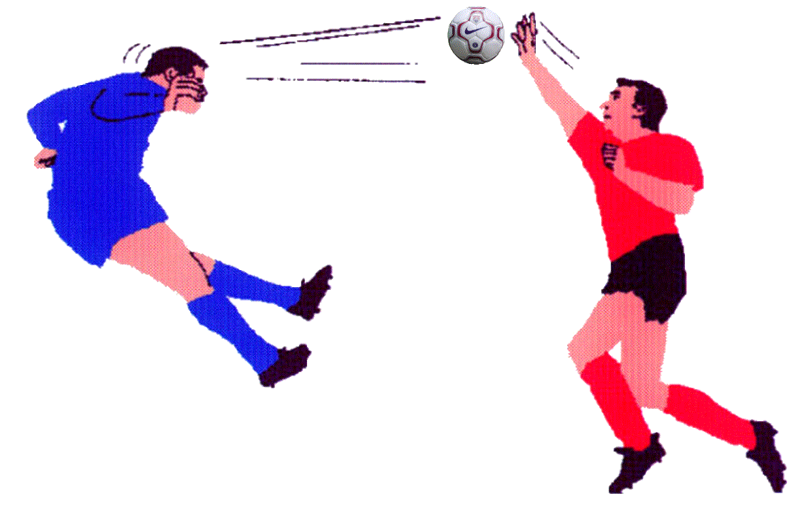
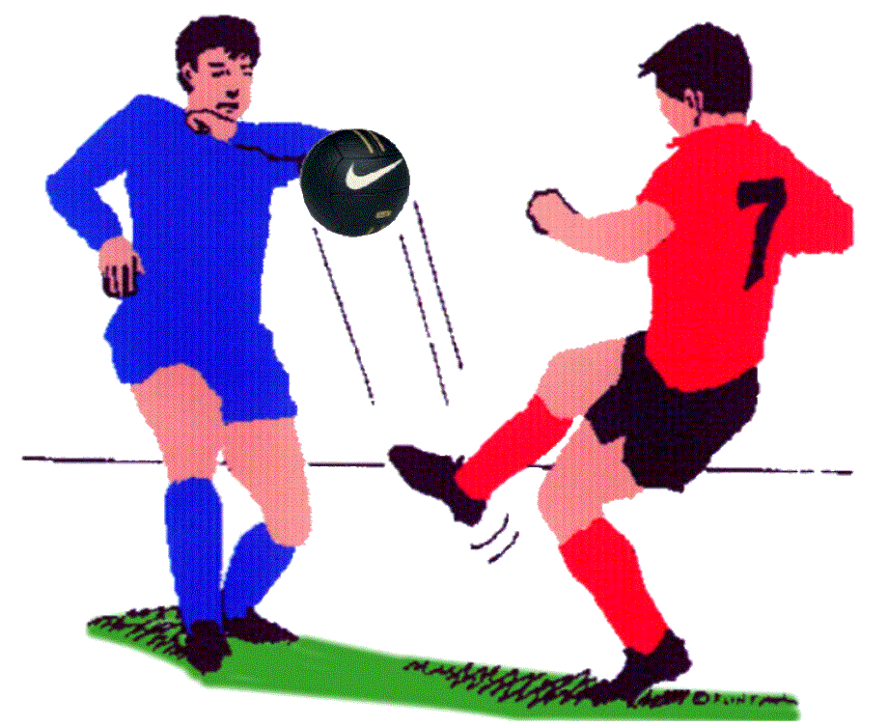
Direct Free Kick Fouls
Handling the ball deliberately..
Handball Foul
Unintentional contact
Not a handball foul
Notes:
Some unintentional contact isn’t a handled ball, but here are the questions that must be asked before you decide.

Slide 22
Direct Free Kick Fouls
Handling? – the Referee must decide….
Deliberate? => Foul
NOT deliberate? => No Foul
Not sure?
Ask yourself….
Was their arm or hand in an unnatural position ?
Did the hand or arm play the ball or vice versa?
Distance to ball and reaction time ?
Did the player make themselves “bigger” ?
Notes:
So ask yourself these questions.
Is the player making themselves bigger. Does the position of the arm or hand allow them occupy space they normally wouldn’t? Then it’s a handled ball.
Is the arm or hand in an unnatural position. Is there is no reason that causes the hand or arm to be where the ball is, then it’s probably a handled ball.
Did the player benefit by denying an opportunity, or did they gain an tactical advantage by such unnatural position of the arm or hand? This should be fairly easy to determine is the referee is reading the game and is close to the play.
If you’re still uncertain after you consider the first 3 questions, then take the following into account before you decide;
What’s the distance between the ball and the arm or hand and how much reaction time did they have? The lesser the distance, the more likely they didn’t have time to react.
Was the hand or arm moved into the path of the ball, or was it vise versa? In this last case, you must see the whole picture and be able to make a judgment quickly.
Let’s look at some videos of possible handled balls.

Slide 23
Direct Free Kick Fouls
Handled Ball – Not Deliberate
Ball strikes player on arm - and - ball falls to player’s feet and the player gains control.
No Foul!
Reasoning…
Player did not initiate the action.
The time of decision is when the ball contacts the player’s arm …. Not after the fact when the ball falls to the player’s feet.

Slide 24
Direct Free Kick Fouls
Restart with a Direct Free Kick (DFK) at point of infraction
Except when foul occurs by defender within the defender’s penalty area
in which case a Penalty Kick shall be awarded
Notes:
All Direct free kicks are taken from the point of infraction with one exception. When the DFK foul is committed by a defender inside their own penalty area, in which case an Penalty Kick should be awarded.

Slide 25
Direct Free Kick Infractions
Law 12 Additional Conditions
A DFK (or PK) is awarded if the ball is in play and a player commits an offense on the field-of-play against:
  a team-mate
  a substitute
  a substituted player
  a team official (either team)
  a match official (referee or AR)
Remember, a FOUL was defined as an offense by a player against an opposing player.
A DFK (or PK) restart is also to be administered for a player committing an offense against any other participant.

