Slide 1

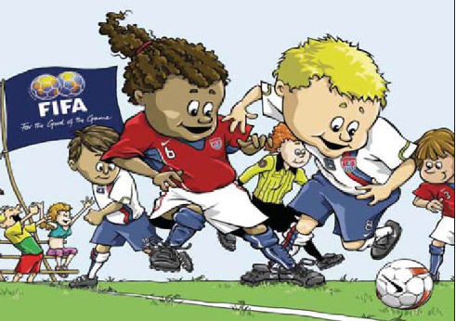
On-Line Review – Part 1 Laws 1-4 & 7-10
2017

Slide 2
LAWS 1 – 4
Goals MUST be anchored securely to the ground. If they cannot be secured, the game must NOT be played.
A. True B. False

Slide 3
LAWS 1 – 4
The penalty marks are located 12 yards from the center of each goal line.
A. True B. False

Slide 4
LAWS 1 – 4
The lines on the field are part of the area they enclose, which means that a ball on the penalty area line is considered to be in the penalty area.
A. True B. False

Slide 5
LAWS 1 – 4
Players are allowed to wear jewelry, such as earrings or a bracelet, as long as it is properly taped.
A. True B. False

Slide 6
LAWS 1 – 4
The required equipment of a player includes shinguards. Shinguards must
A. be covered entirely by the socks.
B. be made of a suitable material (rubber, plastic, or similar material).
C. provide a reasonable degree of protection.
D. satisfy all three of the above requirements.

Slide 7
LAWS 1 – 4
To prevent an injury, the minimum height of the corner flags-post must be at least
  5 feet
Notes:
Emphasize the importance of field safety, especially as it relates to goals and corner flags.
Explain the origin of the term, and define “into touch.” Review in part or in whole the field quiz the students have completed.
Play the field as marked. Nets on the goals are optional.
The location of the Penalty mark is the one exception to playing the field as marked and the one measurement you need to know.

Slide 8
LAWS 1 – 4
The home team is responsible for providing the game ball.
True
Notes:
Emphasize the importance of field safety, especially as it relates to goals and corner flags.
Explain the origin of the term, and define “into touch.” Review in part or in whole the field quiz the students have completed.
Play the field as marked. Nets on the goals are optional.
The location of the Penalty mark is the one exception to playing the field as marked and the one measurement you need to know.

Slide 9
LAWS 1 – 4
The maximum number of players on a U-14 and older soccer team is…
11
The minimum number of players is…
7
Notes:
Referee approves the best ball available and ensures its return at end of match
Must be safe – materials, loose panels, etc
Must be properly inflated – “rule of thumb”
Must be spherical – test by tossing in the air with a spin
Various sizes in youth play

Slide 10
LAWS 1 – 4
What are the five items every player must wear?
Five S’s
Notes:
Referee approves the best ball available and ensures its return at end of match
Must be safe – materials, loose panels, etc
Must be properly inflated – “rule of thumb”
Must be spherical – test by tossing in the air with a spin
Various sizes in youth play

Slide 11
LAWS 1 – 4
  Who is responsible for making sure the field, players equipment and the ball are all safe?
            The Referee
Notes:
Emphasize the importance of field safety, especially as it relates to goals and corner flags.
Explain the origin of the term, and define “into touch.” Review in part or in whole the field quiz the students have completed.
Play the field as marked. Nets on the goals are optional.
The location of the Penalty mark is the one exception to playing the field as marked and the one measurement you need to know.

Slide 12
LAWS 1 – 4
All the players on a team must be dressed in the same color jersey. True or False?
False
Notes:
Emphasize the importance of field safety, especially as it relates to goals and corner flags.
Explain the origin of the term, and define “into touch.” Review in part or in whole the field quiz the students have completed.
Play the field as marked. Nets on the goals are optional.
The location of the Penalty mark is the one exception to playing the field as marked and the one measurement you need to know.

Slide 13
LAWS 7 and 8
You have just awarded a corner kick. Before the kick can be taken, time runs out for the first half. What action should you take?
A. extend time for the taking of the corner kick.
B. start the second half with a corner kick.
C declare the half over because time has expired. Do not allow the corner kick to be taken.
Notes:
8. According to The Laws of the Game, a dropped ball must be performed between two opposing players.
A. True B. False
9. The ball is “out of play” when:
A. it has completely or wholly crossed the entire width of the goal line or the touch line.
B. the referee has blown her whistle
C. if it hits the referee
D. if either A or C occurs.
E. if either A or B or C occurs.

Slide 14
LAWS 7 and 8
The referee has decided to add 2 minutes to the end of the first half. His decision should be based on which factor(s)?
A. Substitutions
B. Removing an injured player from the field
C. Time wasting
D. Any of the above
E. None of the above, the referee can only add time at the end of the game
Notes:
8. According to The Laws of the Game, a dropped ball must be performed between two opposing players.
A. True B. False
9. The ball is “out of play” when:
A. it has completely or wholly crossed the entire width of the goal line or the touch line.
B. the referee has blown her whistle
C. if it hits the referee
D. if either A or C occurs.
E. if either A or B or C occurs.

Slide 15
LAWS 7 and 8
According to The Laws of the Game, a dropped ball must be performed between two opposing players.
A. True B. False
Notes:
10. The ball, while in play, crosses completely over the touchline, but does not touch the ground and is blown back onto the field by the wind. The referee should:
A. allow play to continue since the ball never touched the ground outside the field of play
B. stop play and restart with a corner kick
C. stop play and restart with a goal kick
D. stop play and restart with a throw-in
11. A goal should be awarded if, after an indirect free kick taken by a member of the attacking team, the ball bounces off the goal post, hits an opponent's leg, and then goes into the goal,.
A. True B. False

Slide 16
LAWS 7 and 8
The referee has awarded a penalty kick. Before the kick can be taken, time runs out for the first half. What action should the referee take?
  Extend time for the taking of the penalty kick.

Slide 17
LAWS 7 and 8
Before the start of the game, a coin is tossed, and the team that wins the coin toss has what option
  which goal they will attack.

Slide 18
LAWS 7 and 8
A goalkeeper caught and maintained possession of the ball inside her goal area, but injured herself in the process. The referee stops the game to allow the coach to attend to the goalkeeper. When ready, restart play with a……
  Dropped ball.

Slide 19
LAWS 9 and 10
The ball is “out of play” when:
A. it has completely or wholly crossed the entire width of the goal line or the touch line.
B. the referee has blown her whistle
C. if it hits the referee
D. if either A or B occurs.
E. if either A or B or C occurs.
Notes:
10. The ball, while in play, crosses completely over the touchline, but does not touch the ground and is blown back onto the field by the wind. The referee should:
A. allow play to continue since the ball never touched the ground outside the field of play
B. stop play and restart with a corner kick
C. stop play and restart with a goal kick
D. stop play and restart with a throw-in
11. A goal should be awarded if, after an indirect free kick taken by a member of the attacking team, the ball bounces off the goal post, hits an opponent's leg, and then goes into the goal,.
A. True B. False

Slide 20
LAWS 9 and 10
The ball, while in play, crosses completely over the touchline, but does not touch the ground and is blown back onto the field by the wind. The referee should:
A. allow play to continue since the ball never touched
the ground outside the field of play
B. stop play and restart with a corner kick
C. stop play and restart with a goal kick
D. stop play and restart with a throw-in

Slide 21
LAWS 9 and 10
A goal should be awarded if, after an indirect free kick taken by a member of the attacking team, the ball bounces off the goal post, hits an opponent's leg, and then goes into the goal.
A. True B. False

Slide 22



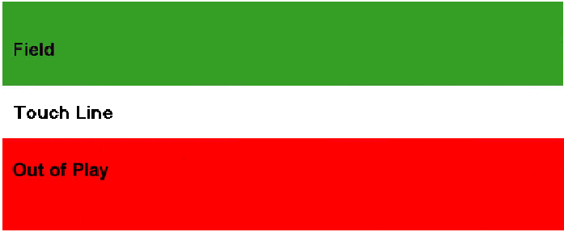

BALL CROSSING LINES
A ball may cross a boundary line on the ground or in the air
A ball is not out if any part of the ball is on or above any part of the line

Slide 23
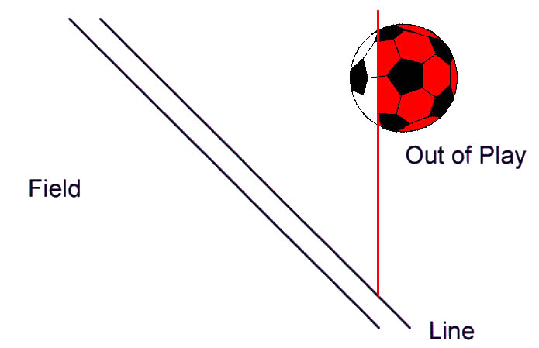
BALL NEAR LINE
?
NO!
Ball above the line is still
“touching” outside plane of line

Slide 24
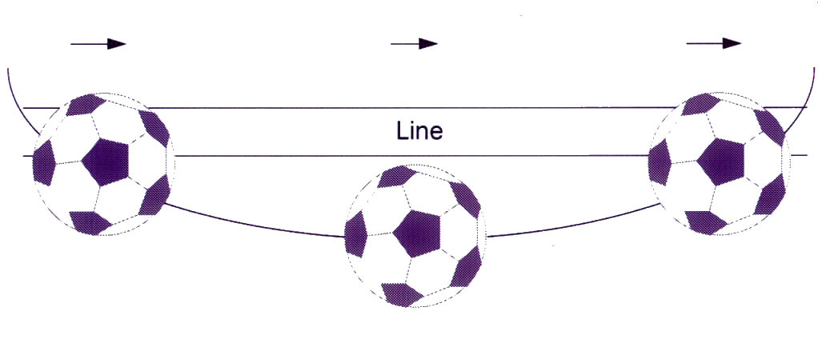
CURVING BALL BLOWN BACK
Field of Play
Out of Play

Slide 25
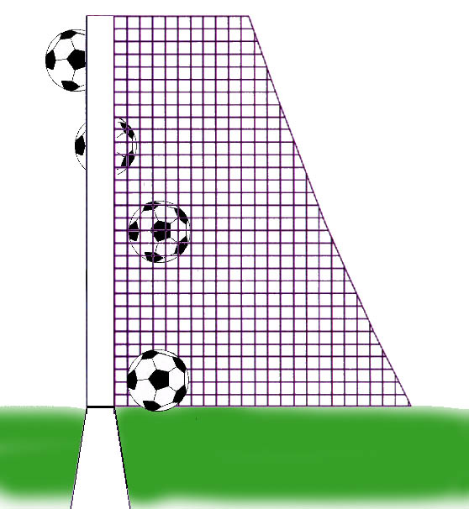
WHAT’S A GOAL? AND WHAT’S NOT?
LAW 10 - Method of Scoring
No Goal
No Goal
Goal
No Goal
Notes:
Define when a goal occurs. Emphasize that the goal line is the key if the goal posts are not in line with it, so where possible the back edge of the goal post should be lined up with outside edge of the line.

Slide 26
LAWS 9 and 10
A shot is taken and the ball is obviously going to enter the goal. Just before it does so, a dog touches the ball, and the ball continues on into the goal. The referee should….
Award the goal.
Notes:
Ball is still in play when it rebounds of a referee, assistant referee, goal posts, or corner flags and does not leave the field. Hitting an outside agent (e.g., spectator, substitute, coach) standing on the touchline would result in a dropped ball.

Slide 27
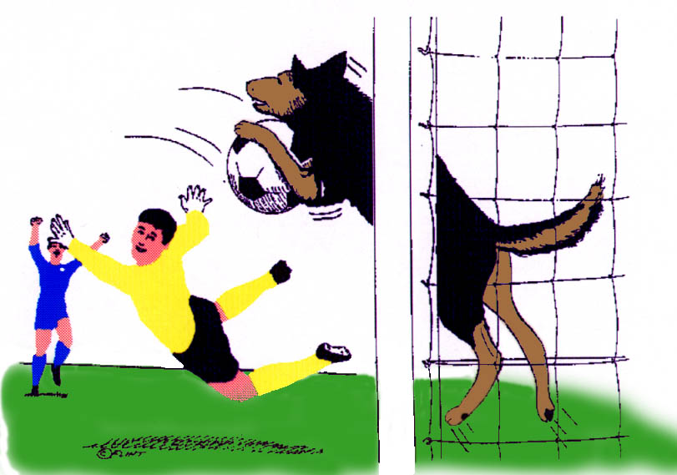
Goal?????
Notes:
The ball is out of play the moment it is interfered with by the outside agent.
Emphasize that the referee can never “award” a goal if it does not score due to outside interference, weather, field conditions, fouls committed by a defender, etc.
Pass out the chart for when a goal can be score directly and goal/no goal.

