Slide 1



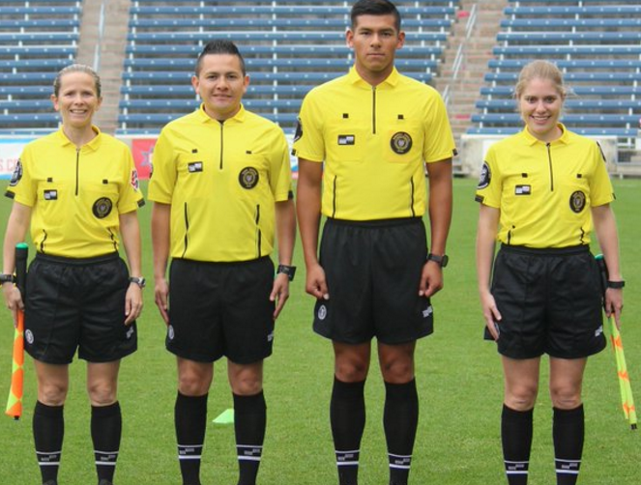



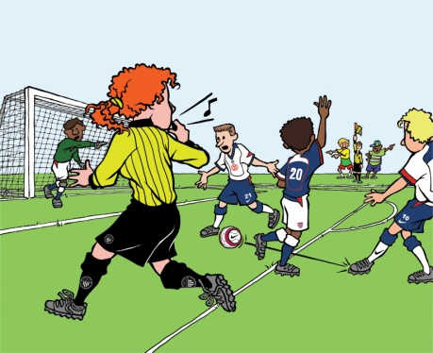


SESSION 1
Powers & Duties and Hands-On
Introduction to being a Referee
Registration
Intro to Law 12 - Fouls
Review – On-Line Test and Laws 1 - 4, 7 & 8
Law 11 - Offside
2017
9, 10, 13 - 17

