Slide 1
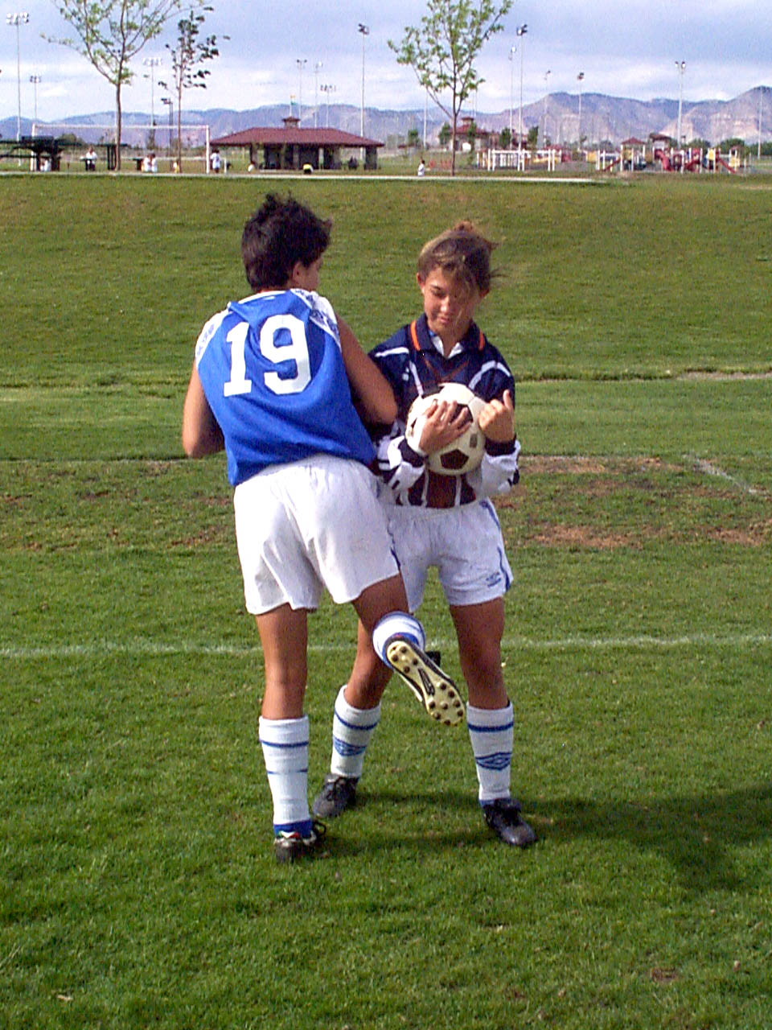
Law 12: Fouls Overview
LAW 12
Fouls and Misconduct
Fouls Overview
2017

Slide 2
FOULS – Definition
A foul is an infraction for which a Direct Free Kick (DFK) or an Indirect Free Kick (IFK) is awarded.

Slide 3
FOULS – Definition
There are the 4 Criteria required for a “foul” to occur.
What are they?

Slide 4
FOULS – Definition
4
What Are They ?

Slide 5
FOULS – Definition
The 4 Criteria are:
Who By
Against Who
Where
When

Slide 6
FOULS – Definition
A DFK or IFK is awarded for a FOUL if the infraction was committed:
by a player
against an opponent who is also a player (except handling)
on the field of play
while the ball is in play

Slide 7
How Many Kinds of Fouls are there??
DFK and IFK Fouls
Two Kinds of Fouls
What are They ??
DFK and IFK Fouls

Slide 8
DIRECT FREE KICK (DFK) FOULS
DFK Fouls
How Many??
10

Slide 9
DFK FOULS – 10 TOTAL
The first 7 DFK fouls result in a DFK if the referee decides it was done carelessly, recklessly or using excessive force. WHAT ARE THEY??
Four (4) with the Hands or Upper Body
Pushes an opponent
Strikes or attempts to strike an opponent
Charges an opponent
Jumps at an opponent

Slide 10
DFK FOULS – 10 TOTAL
The first 7 DFK fouls result in a DFK if the referee decides it was done carelessly, recklessly or using excessive force. WHAT ARE THEY??
Three (3) with the Feet
Kicks or attempts to kick an opponent
Trips or attempts to trip an opponent
Tackles or Challenges an opponent

Slide 11
DFK FOULS – 10 TOTAL
The other 3 DFK fouls are??
Holds an opponent
Spits at an opponent
Handles the ball deliberately (except for the goalkeeper within his/her own penalty area)

Slide 12
INDIRECT FREE KICK (IFK) FOULS
IFK Fouls
How Many??
7
4 by the Goalkeeper
3 by the Players

Slide 13
IFK FOULS – 7 TOTAL
What are the
4 by Goalkeeper Inside Own Penalty Area?
Takes more than 6 seconds while controlling the ball with their hands before releasing it from their possession
Touches ball again with hands prior to touch by another player
Touches ball with hands after it is deliberately kicked to him/her by a team-mate
Touches ball with hands after receiving it directly from throw-in by team-mate

Slide 14
IFK FOULS – 7 TOTAL
What are the 3 by Players?
Plays in a dangerous manner
Impedes the progress of an opponent
Prevents goalkeeper from releasing the ball

Slide 15
DFK or IFK
Quick Rule of Thumb
If the offence involves contact it is penalized by a DFK.

