Slide 1
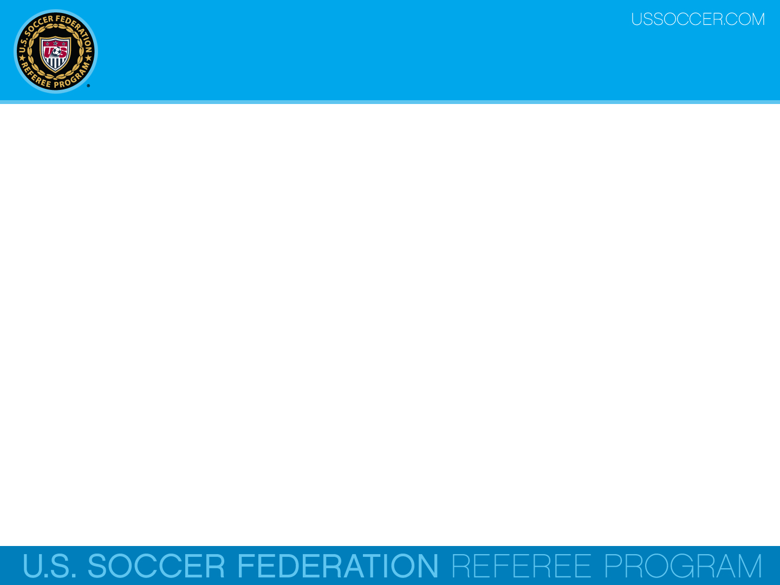

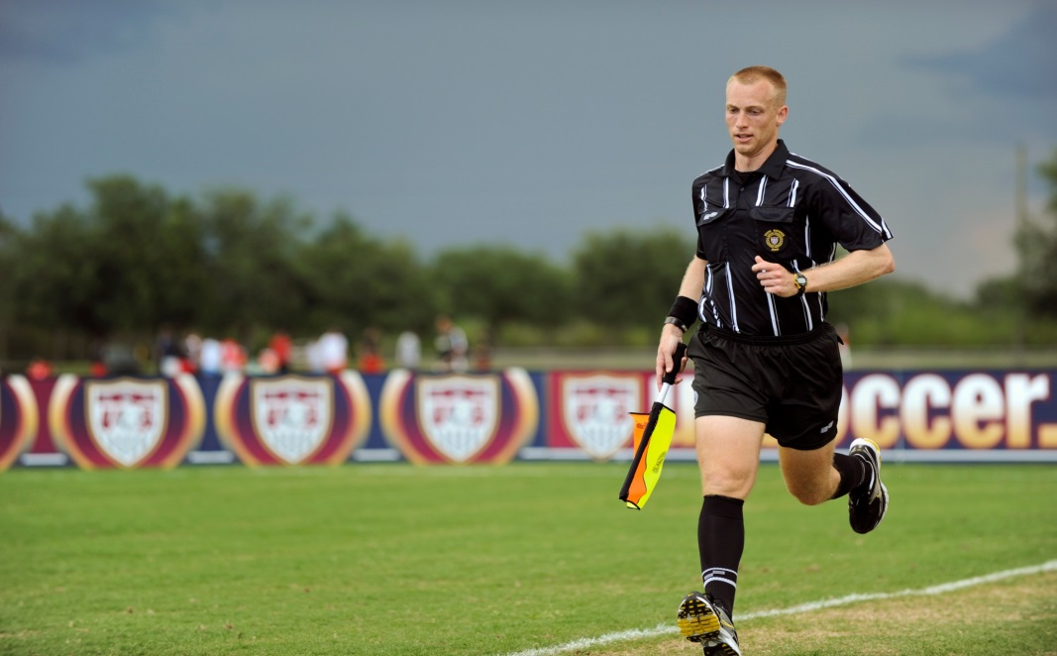
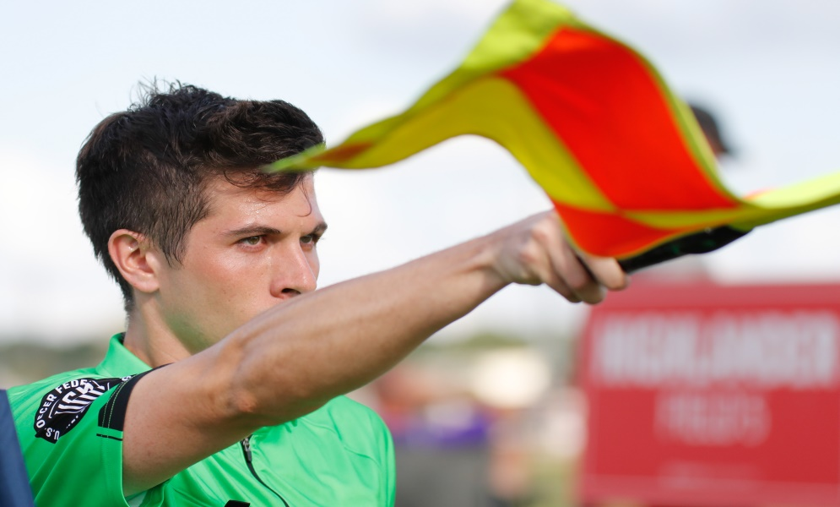
Law 6 - The Other Match Officials
U.S. Soccer Federation Referee Program
Entry Level Referee Course
Competitive Youth Training
Small Sided and Recreational Youth Training
2016-17
Notes:
Online Training Script:
Welcome to U.S. Soccer’s online training for the Grade 8 & 9 Referee Course.
Grade 8 training is specific to preparing officials for the competitive youth game.
Grade 9 training is specific to preparing officials for the small sided and recreational youth game.
This presentation focuses on Law 6 – The Assistant Referees.

Slide 2
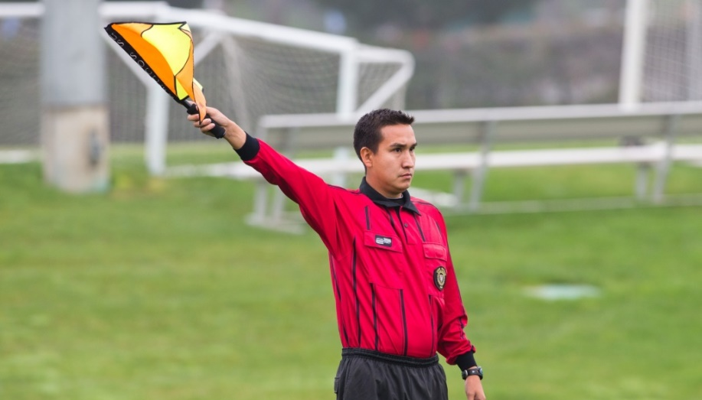
Authority
Law 6 explains all the duties of the assistant referee (AR). These are all are subject to the final decision of the referee.
Most competitive youth games will have two ARs assigned. However, in some small-sided and recreational youth games, there may be no ARs assigned and the referee will need to officiate the match alone.

Slide 3
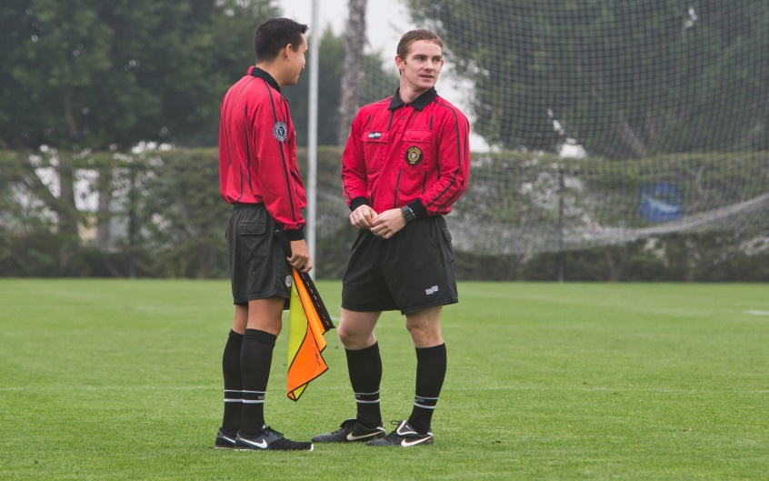
Assistance
The AR should be prepared to provide assistance and information to the referee.
It is important to remember that in accordance with Law 6, all information provided by the AR is subject to the final decision of the referee.

Slide 4
Assistance
Whether being assigned as a referee or AR, all officials should know the Laws of the Game and what is expected of both positions.
Proper preparation is important for the overall success of the referee team. ARs should be ready to fill in for the referee in case of injury or illness during the game.

Slide 5
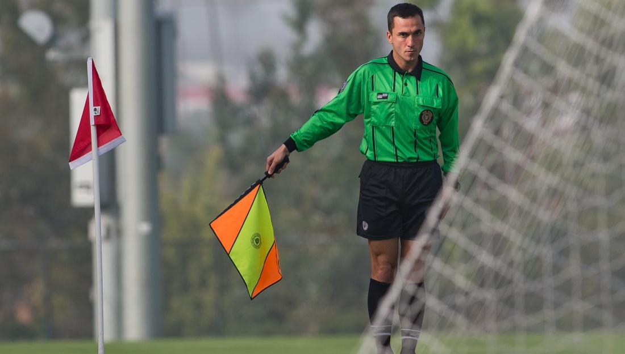
Duties
It is the specific duty of the ARs to help the referee control the game and enforce the Laws of the Game.

Slide 6
Duties
The AR’s primary duties include indicating:
When a player should be penalized for an offside offense
When a legal goal has been scored
When the entire ball has crossed out of the field-of-play
Which team is entitled to a corner kick, goal kick or throw-in
When a substitution has been requested

Slide 7
Assistance
Other common items requiring assistance would include:
Inspecting the field, balls and players’ equipment
Maintaining back-up records of time, goals and misconduct
Monitoring the substitution procedure
Determining if problems with equipment or bleeding have been resolved

Slide 8
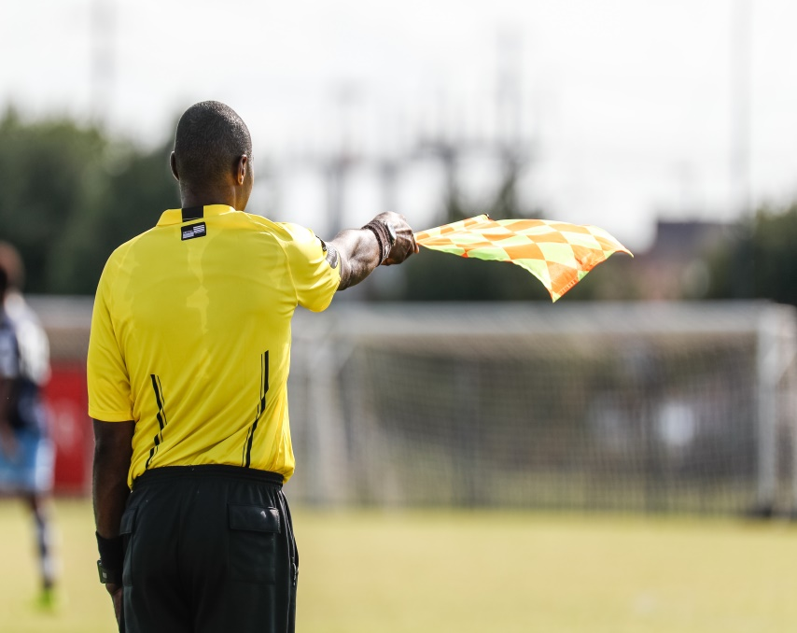
Assistance
The AR can also assist in any other game situations at the request and direction of the referee, such as assisting with managing players.
One example might be if the referee (in the pre-game) asks an AR to enter the field to manage a wall close to the touch line.

Slide 9
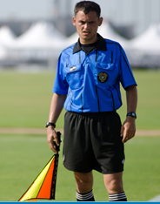
Assistance
ARs should also indicate:
When misconduct or any other incident occurs out of the view of the referee,
When offences have been committed whenever an AR has a better view than the referee ,
During a penalty kick, when the goalkeeper moves off the goal line before the ball is kicked.

Slide 10

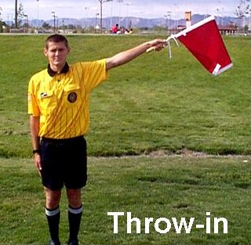
AR Signals

Slide 11
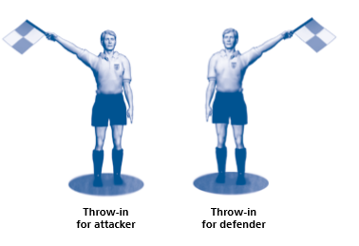
AR Signals

Slide 12

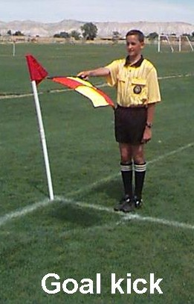
AR Signals

Slide 13

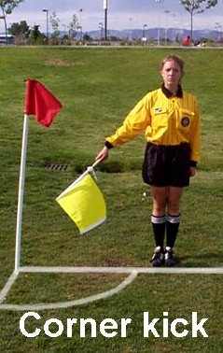
AR Signals

Slide 14
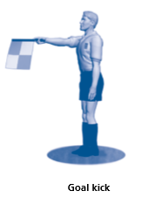
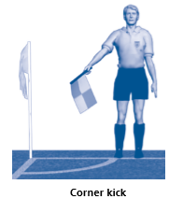
AR Signals

Slide 15
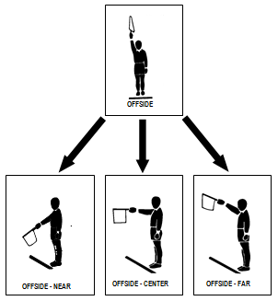
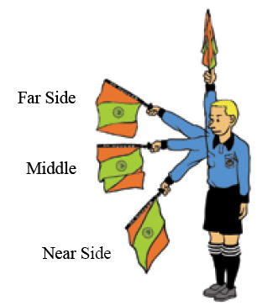
AR Signals

Slide 16
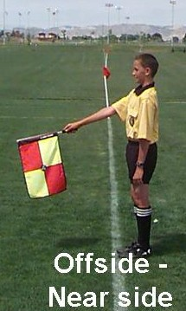
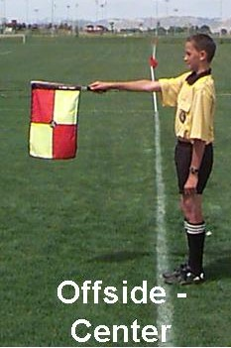
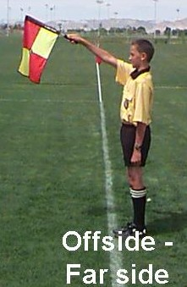
AR Signals

Slide 17
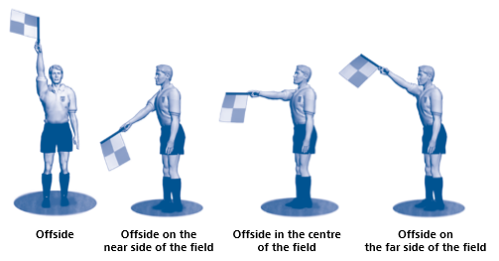
AR Signals

Slide 18
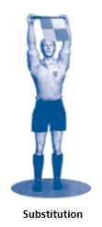

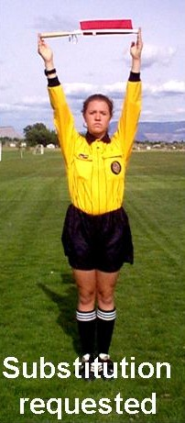
Signals

Slide 19
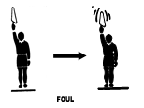
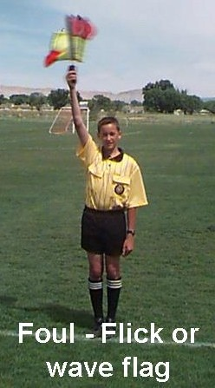
AR Signals

Slide 20
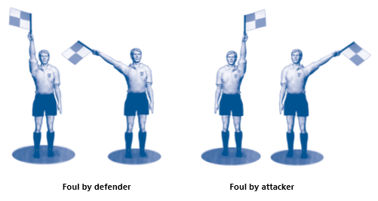
AR Signals

Slide 21
Mechanics
Each AR runs off the field of play just outside the touchline, between the goal line and the halfway line.
ARs should be sure to follow play all the way to the goal line when needed.
Following the ball all the way to the goal line is very important. An AR can then see better when the ball has left the field-of-play and for determining if a goal is scored or not.

Slide 22
Positioning
The ARs primary position is to stay even with the second-to-the last defender or the ball, whichever is closer to the goal line.
This is important in order to assist the referee in determining when players are offside.
Note that the goalkeeper is usually the last defender, but this is not always the case.
Notes:
Online Training Script:

Slide 23

Positioning
Maintaining the proper positioning for assistant referees takes experience and focus.
The AR’s most important duty is to indicate offside offenses. Correct positioning is very important for this.
It is also important for an AR to use the correct signals and mechanics, so as not to confuse other members of the referee team.

Slide 24
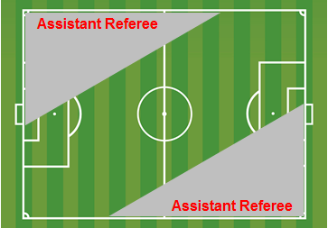
Positioning
The diagonal system of control allows referees to keep play between them and the ARs, because two perspectives on the same play is better than one.

Slide 25
Positioning
Because the ARs should be keeping in line with the second-to-last defender or the ball, there is a limited area of the field they can supervise.
However, these areas are important for the ARs to monitor so that the referee can focus on a more manageable amount of the field.

Slide 26
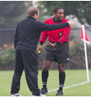
Management
When helping manage behavior issues with coaches or spectators, ARs should follow the pre-game instructions provided by the referee.
At a minimum, this should include getting the attention of the referee and making them aware of the issue so it can be dealt with.

Slide 27
Management
The referee and ARs are a team, so referees must provide the support needed and make sure all members of the team are being treated with respect.
This means that referees should have a zero tolerance policy whenever their ARs are inappropriately targeted by coaches or spectators.

Slide 28
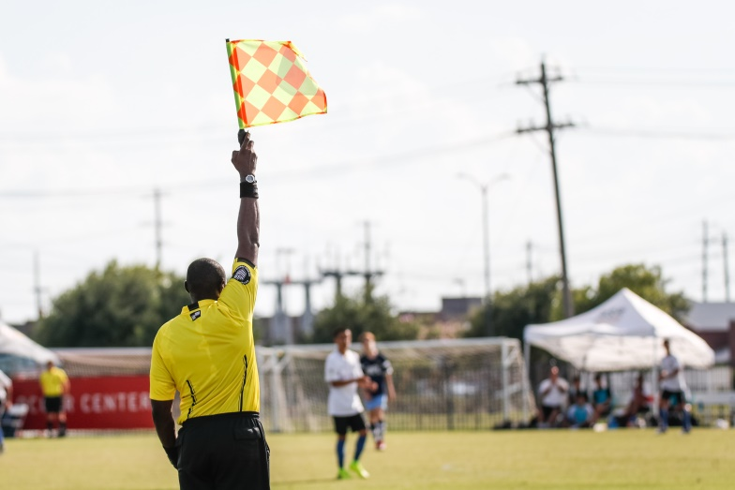
Communication
Good communication is essential for the entire referee team. Since ARs don’t use whistles, they must learn to communicate in other ways.
ARs provide information to the referee thru the use of proper flag signals and mechanics.
Verbal communication should only be used when it is absolutely necessary.

Slide 29
Communication
Eye contact between the referee and ARs is critical.
Making eye contact with the referee at every opportunity is very important and at a minimum the AR and referee should make eye contact with each other at every stoppage in play.

Slide 30
Communication
ARs should always look for the referee before signaling with the flag.
Remember, as an AR you are providing information and assistance.
It is the referee who makes the “final decision” based on the information that you provide as the AR.

Slide 31
Review Question
29. The recommended position for the AR during play is which of the following?
  Even with the ball
  Even with the second to last defender
  Even with the ball or the second to last defender, depending on which is closer to the goal line
  Even with the first attacker

Slide 32
Review Question
30. Should the AR signal by raising the flag vertically in the right hand each time a player is in an offside position?
        Yes
        No

Slide 33
Review Question
31. Which of the following should the assistant referee indicate?
  When the ball has left the field of play
  When a player should be penalized for an offside offense
  When a substitution has been requested
  All of the above

Slide 34
Review Question
32. Should assistant referees follow the ball all the way to the goal line when it goes past the second to last defender?
      Yes
      No

Slide 35
Review Question
33. When the ball crosses out of play for a throw-in, should the AR signal with the flag 45 degrees upward in the direction of the throw-in?
          Yes
          No

Slide 36
Review Question
34. How should the AR signal when the ball crosses over the goal line for a corner kick to be taken on the far side of the field?
    Point the flag 45 degrees downward in the direction of the nearest corner flag
    Signal with the flag 45 degrees upward in the direction of the far-side corner.

Slide 37
Review Question
35. How should the AR signal if the ball crosses out of play over the touch line and then immediately back into play?
  Raise the flag vertically in the hand and then, after the referee stops play, signal with the flag 45 degrees upward in the direction of the restart
  Leave the flag down and let play continue

