Slide 1
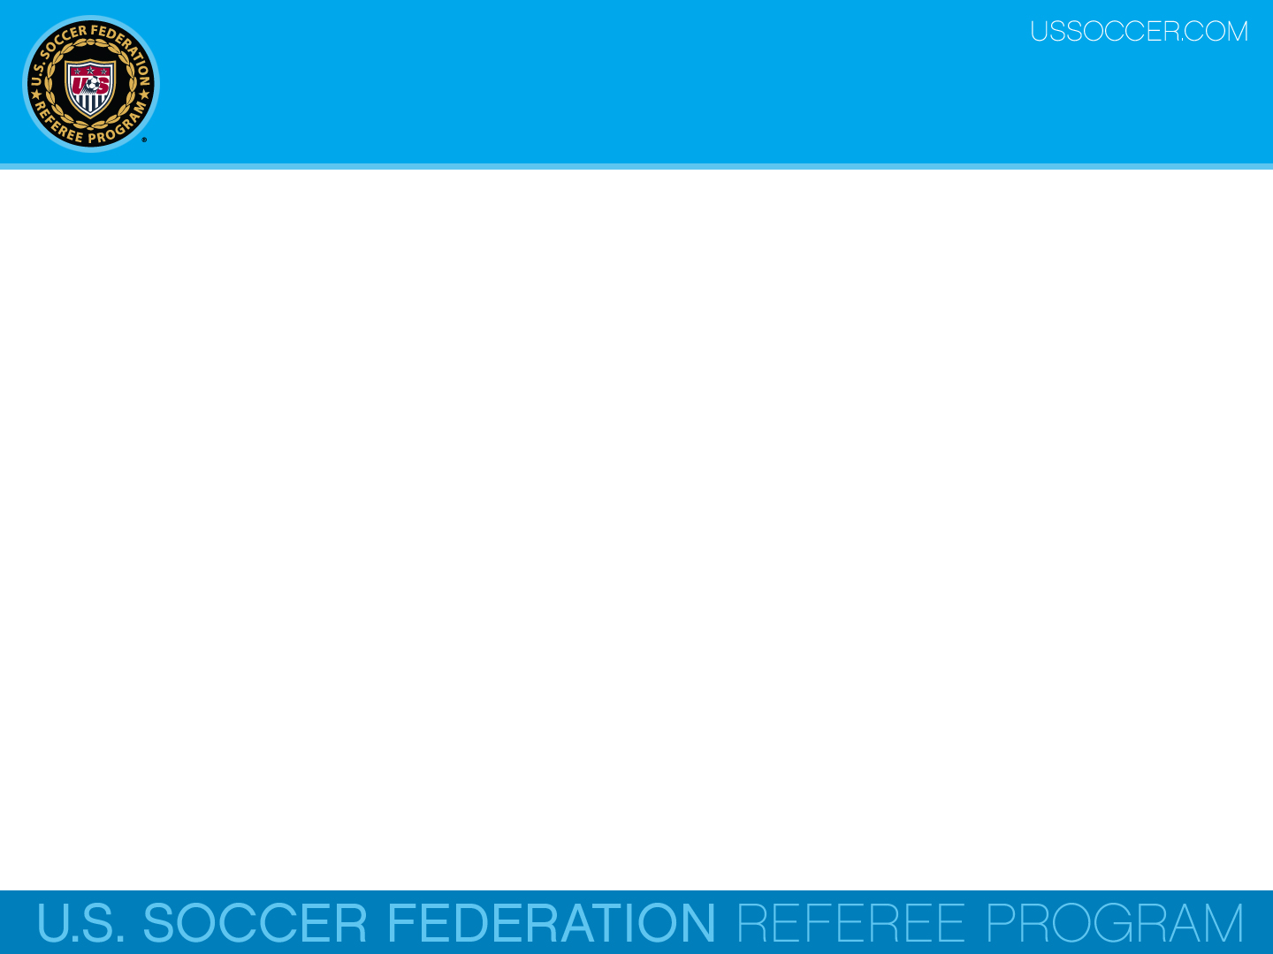

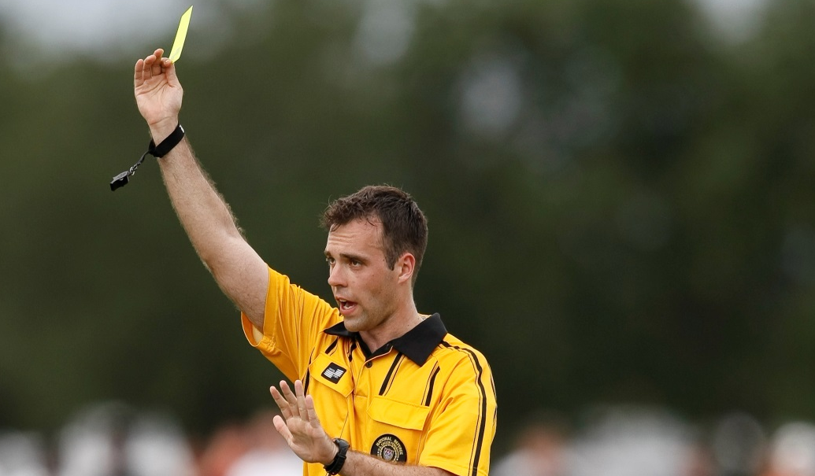
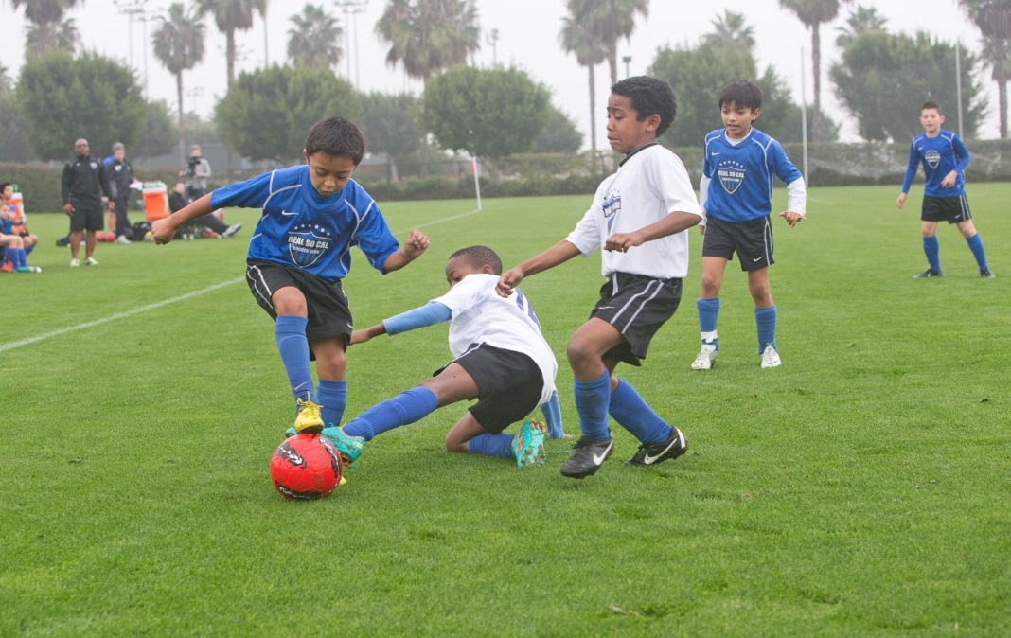
Law 12 - Fouls & Misconduct
U.S. Soccer Federation Referee Program
Entry Level Referee Course
Competitive Youth Training
Small Sided and Recreational Youth Training
2016-17
Notes:
Online Training Script:
Welcome to U.S. Soccer’s online training for the Grade 8 & 9 Referee Course.
Grade 8 training is specific to preparing officials for the competitive youth game.
Grade 9 training is specific to preparing officials for the small sided and recreational youth game.
This presentation focuses on Law 12 – Fouls and Misconduct.

Slide 2
Law 12 Overview
The Law 12 is separated into two parts. The first part is about fouls and the second part deals with misconduct.
Fouls
  Direct free kick fouls (DFK)
  Indirect free kick fouls (IFK)
Misconduct
  Cautionable offenses
  Sending-off offenses

Slide 3
Part 2 – Misconduct

Slide 4
Misconduct
Unlike the specific requirements for a foul, misconduct can occur at any time, including before and after the game, on or off the field, while the ball is in play or not, committed by persons other than players, and not necessarily against opponents.
The referee has the authority to take action against players guilty of misconduct.
The referee’s authority to take disciplinary sanctions begins from the moment they arrive at the field and continues until they leave.
Notes:
The yellow card is used to communicate that a player or substitute has been cautioned.
The red card is used to communicate that a player or substitute has been sent off.
Only a player or substitute may be shown a yellow or red card.
Classroom Instructor Talking Points:

Slide 5
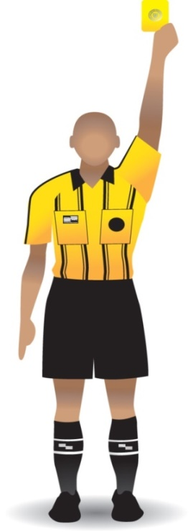
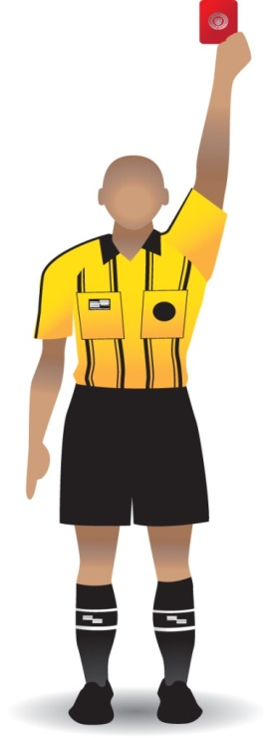
Misconduct
The yellow card is used to communicate that a player or substitute has been cautioned.
The red card is used to communicate that a player or substitute has been sent off.
Usually, only players or substitutes may be shown cards. However, local rules of competition may allow cards to be shown to coaches and team officials in some instances.

Slide 6

Cautionable Offenses
There are only seven (7) reasons to caution players, however, there are many more actual causes, which will be discussed.
A good way for officials to remember the seven cautionable offenses is with the acronym FEDDD UP.

Slide 7
Cautionable Offenses
A player is cautioned and shown a yellow card if they commit any of the following seven (7) offences:
Fails to respect required distance
Enters or re-enters field without permission
Deliberately leaves field without permission
Dissent by word or action
Delays the restart of play
Unsporting behavior
Persistently infringes the Laws of the Game

Slide 8
Yellow Card
  Failure to Respect the Required Distance –Opponents are required to yield the required distance when play is restarted with a free kick, throw-in, or corner kick.
    Referees (and ARs) should be proactive by having presence and being vocal as needed.
    Often, just telling the defenders to move back is enough to prevent a caution.
Referees, however, should not interfere with a team’s desire to take a quick restart.
Referee report code (FRD)

Slide 9
Yellow Card
  Failure to Respect the Required Distance –
  10 yds from corner arc ( 8 yds U-12 and younger)
  10 yards from opponent’s free kick (8 yds
  U-12 and younger)
  2 yards from opponent’s throw-in

Slide 10
Yellow Card
  Entering or re-entering without permission is when a player or substitute comes onto the field-of-play without the permission of the referee.
This can happen at the start of play if a player arrives late, or during play if the player is off the field to correct an equipment issue or receive medical treatment.
If, after leaving the field of play without the referee’s permission, the referee must caution the player for entering the field w/o permission.
Referee report code (E)

Slide 11
Yellow Card
Deliberately leaving without permission
is when a player leaves the field without the specific or implied permission of the referee.
It does not refer to players who’s momentum during play causes them to temporarily leave the field.
Referee report code (L)

Slide 12
L
  When player leaves field to gain advantage
    Allow play to continue
    Issue caution at next stoppage
    Caution, if team gains a tactical advantage
  Trifling, if not done to gain unfair advantage

Slide 13
L
Players often leave the field for unsporting reasons, i.e. to create an unfair offside situation.
If this happens, the player should still be considered to be on the field for the purpose of determining the offside position of an opponent.
The referee should allow play to continue, so as to not take the advantage away from the attacking team.

Slide 14
L
The player who deliberately left the field without the referee’s permission should then be cautioned at the next stoppage.
If a player does leave the field for some other reason without the referee’s permission to do so, and this results in gaining a tactical advantage for their team, the player has committed misconduct and must be cautioned and shown the yellow card.

Slide 15
L
Where it is apparent to the referee that the player leaving the field without permission has not done so to express dissent or to gain an unfair advantage, the referee can consider this to be a trifling breach of the Laws of the Game.

Slide 16
L
Some trifling examples of this might include changing shoes, replacing a damaged jersey or drinking water during a stoppage.
A verbal warning to the player should be sufficient in such circumstances.
However, if that player then re-enters the field without obtaining the referee's permission, then the caution should be given.

Slide 17
Yellow Card
Dissent by word or Action – is verbal or non-verbal action that disputes or argues with any decisions by the referee, ARs, or fourth official. Referees must deal with dissent because it:
  questions the authority of the referee,
  reduces the flow of the game,
  reduces the enjoyment of other participants and spectators, and
  can spread and potentially lead to bigger problems if not dealt with.
Referee report code (DT)

Slide 18
DT
  Referees need to be proactive and set firm expectations that dissent will not be tolerated.
Please note that team captains have no special status or privileges under the Laws of the Game, but they do have a degree of responsibility for the behavior of their teammates.

Slide 19
DT
A player who is guilty of dissent by protesting (verbally or non-verbally) against a referee’s decision must be cautioned.
Note that this does not apply to any type of offensive, insulting, or abusive language or gestures. These actions are sending-off offences and will be covered later in this presentation.

Slide 20
Yellow Card
Delaying the restart of play –
some common ways players delay a restart include:
    Kicking or carrying the ball away
    Excessively delaying throw-in or free kick
    Delaying substitution process
    Deliberately touching the ball after play stops
    Free kick from wrong position
Referee report code (DR)

Slide 21
DR
Referees must caution players who delay the restart of play.
Some common tactics used at the competitive youth level include:
Purposely taking a free kick from the wrong position with the sole intention of forcing the referee to order a retake.
Kicking the ball away, carrying it away or grabbing it away from an opponent after the referee has stopped play.

Slide 22
DR
Excessively delaying the taking of a throw-in or free kick or appearing to take a restart but suddenly leaving it teammates to take.
Delaying leaving the field of play when being substituted.
Provoking a confrontation by deliberately touching the ball after the referee has stopped play.
Appearing to take a throw-in, but suddenly leaving it to a team-mate to take.

Slide 23
Yellow Card
Unsporting Behavior –
Here are some (but not all) UB reasons a player or substitute must be cautioned:
  Committing one of the DFK fouls in a reckless manner.
  Changing places with the goalkeeper during play or without the referee’s permission.
  Committing any DFK or IFK foul for the tactical purpose of interfering with or breaking up a promising attack.

Slide 24
Yellow Card
Unsporting Behavior –
Committing simulation by attempting to deceive the referee by faking injury or pretending to have been fouled.
Verbally distracting an opponent during play or at a restart.
Using a deliberate trick to pass the ball to their own goalkeeper with their head, chest, knee, etc. in order to circumvent the Laws, whether or not the goalkeeper touches the ball.

Slide 25
Yellow Card
Unsporting Behavior –
Holding an opponent for the tactical purpose of pulling the opponent away from the ball or preventing the opponent from getting to the ball.
Making unauthorized marks on the field of play. Typically committed by goalkeepers.
Playing the ball when they are walking off the field of play after being granted permission by the referee to leave the field during play.

Slide 26
Yellow Card
Unsporting Behavior –
  Tactical foul to break up promising attack
  Handling for tactical purposes
  Whether successful or not, handling the ball in an attempt to score a goal
  Handles the ball in an unsuccessful attempt to prevent a goal
  Acting in a manner which shows a lack of respect for the game.
Referee report code (UB)

Slide 27
UB
In addition, there are certain goal scoring celebrations that are also cautionable offenses.
While it is permissible for a player to demonstrate their joy when a goal has been scored, the celebration must not be excessive.
Reasonable celebrations are allowed, but the practice of choreographed celebrations should not be tolerated when it results in excessive time-wasting . Referees are instructed to intervene in such cases.

Slide 28
UB
A player must be cautioned if, in the opinion of the referee, he or she commits any of the following:
Carries the celebration into and among the spectators.
Makes are provocative or inflammatory gestures
Removes their shirt or covers their head with the shirt
Covers their head or face with a mask or other similar item

Slide 29
UB
Leaving the field of play to celebrate a goal is not a cautionable offence in itself but it is essential that players return to the field as soon as possible.
Referees are expected to act in a preventative manner and be practical when dealing with the celebration of a goal.

Slide 30
UB
Unsporting Behavior
  Excessive celebration of a goal
    Makes gestures which are provocative, derisory or inflammatory
    Celebrates among spectators
    Removes shirt or covers head with shirt
    Covers head or face with other item

Slide 31
Yellow Card
  Persistent Infringement –
  is when a player repeatedly commits fouls or certain other infringements.
    There is no specific number of infringements that defines PI, but if a player (or team) persistently violates the Laws, they should be warned and then cautioned if they soon thereafter commit another foul.
Referee report code (PI)

Slide 32
PI
Referees should be alert at all times to players who persistently infringe the Laws.
In particular, they must be aware that, even if a player commits a number of different offenses, they must still be cautioned for persistent infringement.

Slide 33
PI
Because there is no specific number of infringements that defines persistent or the presence of a pattern, the referee should warn a player who appears to be heading toward this form of misconduct.
Once warned, that player should be cautioned if they soon thereafter commit another foul.
This is entirely a matter of judgment and must be determined in the context of effective game management.

Slide 34
Yellow Cards & Substitutes
Of the seven (7) reasons to caution for players on the field, there are only four (4) that apply to substitutes and substituted players.
A substitute or substituted player is cautioned if they commit any of the following three offenses:
Dissent by word or action
Unsporting behavior
Delaying restart of play
Enters or re-enters the field without referee’s permission

Slide 35
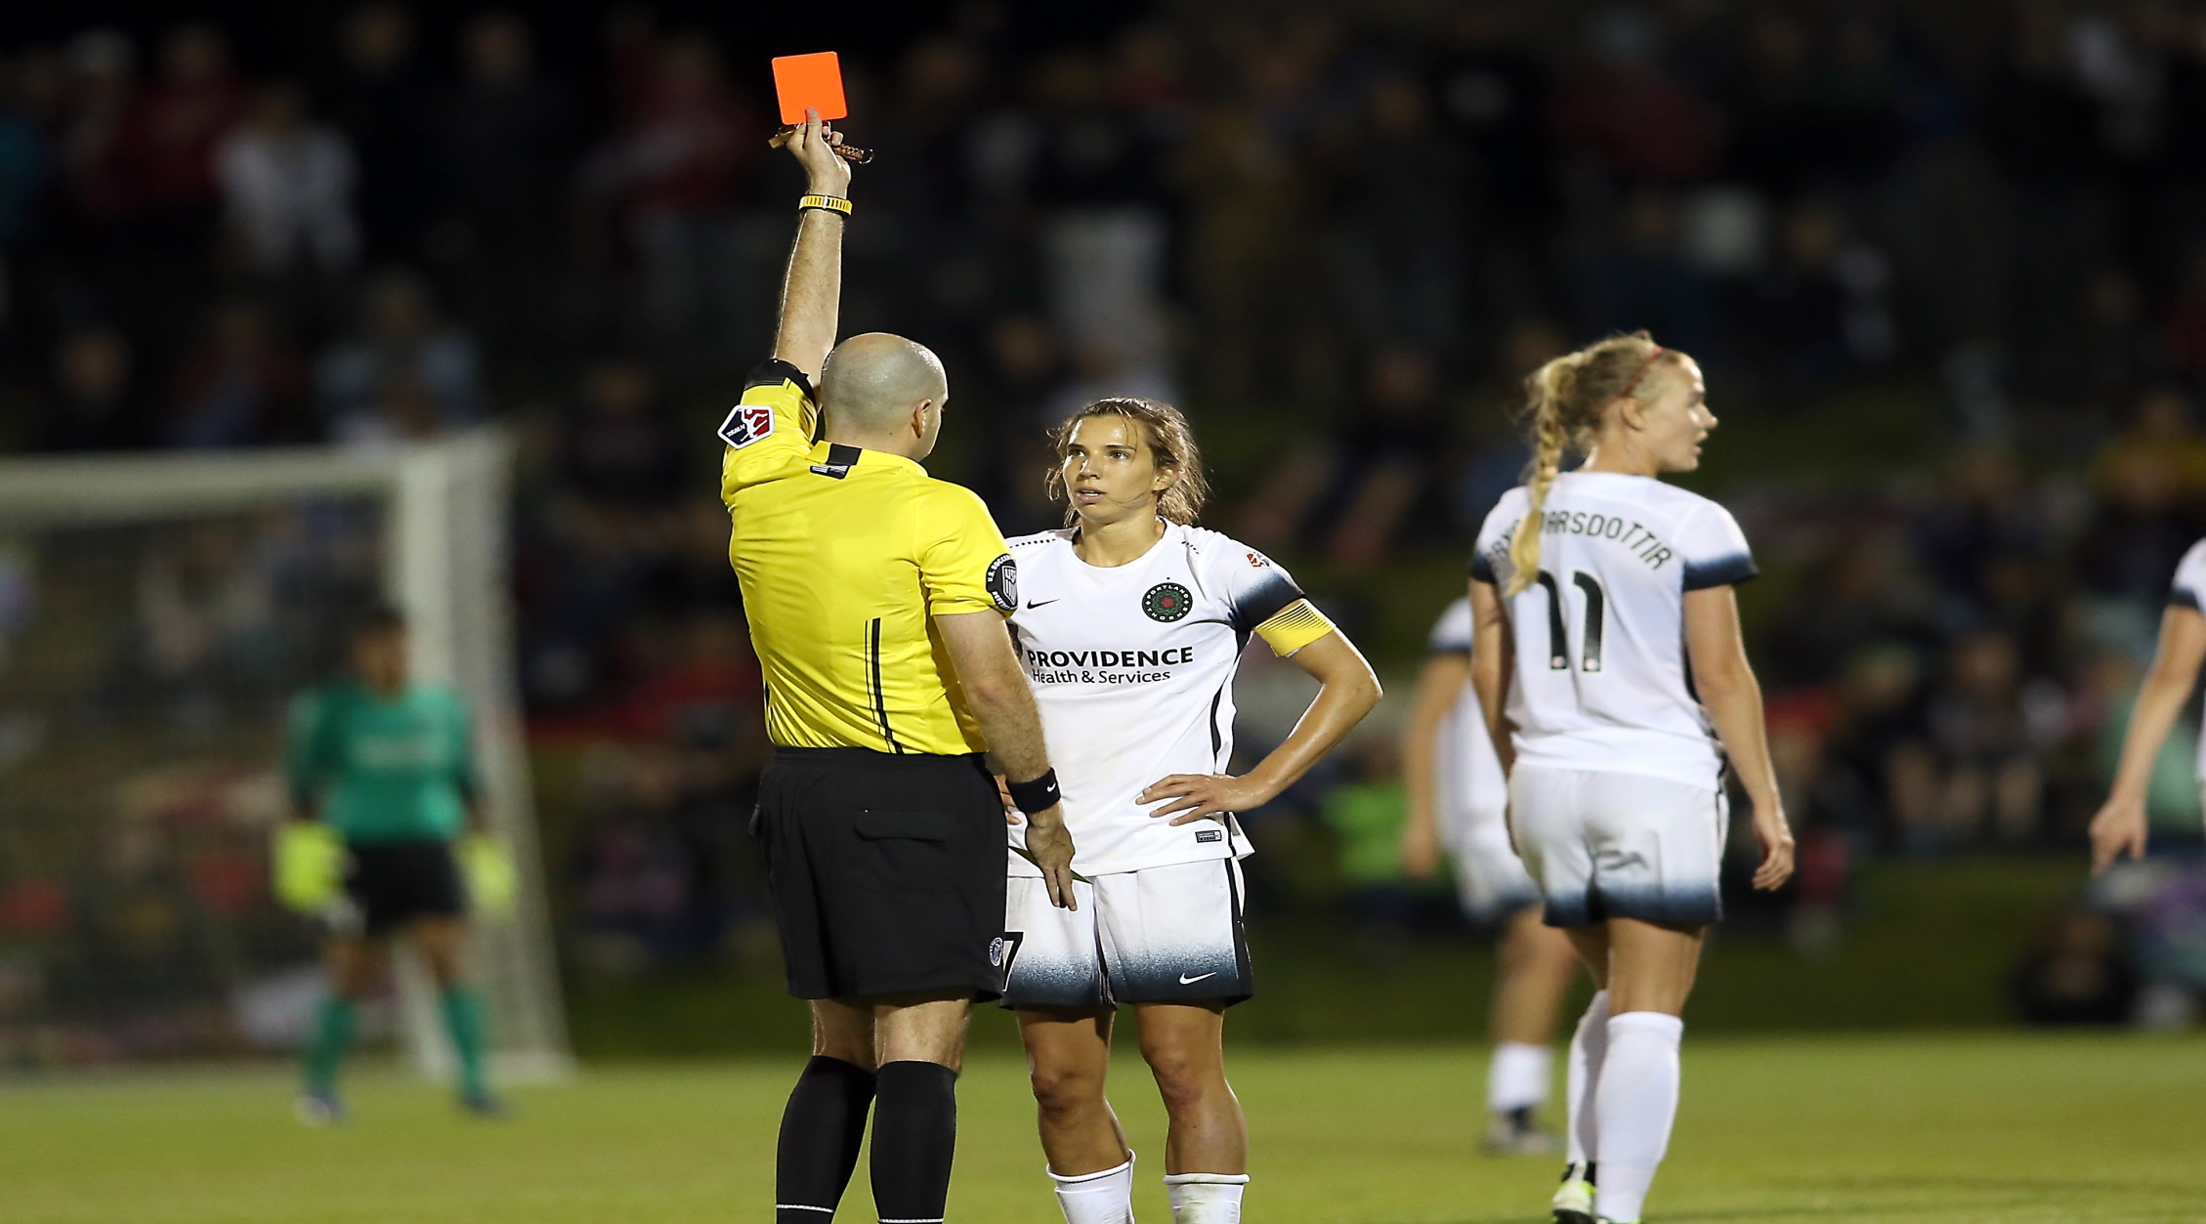
Red Card

Slide 36
Red Card
A player is sent-off and shown a red card if they commit any of the following seven (7) offenses:
  Serious foul play
  Violent conduct
  Uses offensive, insulting or abusive language or gestures
  Spitting at an opponent or any other person

Slide 37
Red Card
  Denies an obvious goal scoring opportunity to an opponent moving towards the opponents goal by an offense punishable by a free kick
Denys the opposing team a goal or an obvious goal scoring opportunity by deliberately handling the ball - this excludes the goalkeeper with their own penalty area
Receives second caution in the same match

Slide 38
Red Card
According to the Laws of the Game, a player or substitute, who has been given a red card and sent off, must leave the vicinity of the field of play and the technical area.
However, some leagues and events may allow sent off individuals to remain at the field, so it’s important for referee to know the local rules of competition.
If this isn’t specified by the local rules of
competition, it is recommended youth players remain with their team and an adult team official, as long as they act responsibly.

Slide 39

SFP
Serious Foul Play
  Must meet criteria for a foul
  Excessive force or brutality against opponent when challenging for the ball
  Tackle that endangers safety of opponent
  Challenge for ball that endangers safety of opponent
Referee report code (SFP)

Slide 40
SFP
In order to issue a red card for serious foul play, all of the criteria associated with a foul must be present.
This means that it must be committed by a player, against an opponent who is a player, on the field, and while the ball is in play.
If any of these criteria have not been met, that doesn’t mean that a red card isn’t justified, it just means that the misconduct would be reported for another reason.

Slide 41
SFP
A player is guilty of serious foul play if he or she uses excessive force or brutality against an opponent when challenging for the ball when it is in play.
Any tackle or challenge that endangers the safety of an opponent must also be sanctioned as serious foul play.

Slide 42
SFP
Any player who lunges at an opponent in challenging for the ball from the front, from the side or from behind using one or both legs, with excessive force and endangering the safety of an opponent is guilty of serious foul play.
Advantage should not be applied in situations involving serious foul play unless there is a clear opportunity to immediately score a goal.

Slide 43
SFP
The referee must send off the player guilty of serious foul play when the ball is next out of play.
A player who is guilty of serious foul play should be sent off and play is restarted with a DFK from the position where the offense occurred or a penalty kick, if the offense occurred inside the offender’s penalty area.

Slide 44
VC
Violent Conduct
  Uses or attempts to use excessive force or brutality against:
  an opponent when not challenging for the ball
  a teammate, team official, match official, spectator or any other person
  regardless of whether contact is made.
Referee report code (VC)

Slide 45
VC
Violent Conduct
  By a player, who when not challenging for the ball, deliberately strikes an opponent or any other person on the head or face with the hand or arm is guilty of violent conduct … unless the force used is negligible.

Slide 46
VC
In the rare occurrence where advantage is applied the referee must send-off the player guilty of violent conduct when the ball is next out of play.
Referees are reminded that violent conduct often leads to mass confrontation and other problems, therefore they must be proactive and timely when dealing with violent conduct misconduct.

Slide 47
AL
Abusive Language
  Personal
  Public
  Provocative
  Zero tolerance for remarks or actions that are discriminatory or racist
Referee report code (AL)

Slide 48
AL
This sending off offense is for the use of offensive, insulting or abusive language and/or gestures.
The referee should judge offensive, insulting, or abusive language according to the specific words or actions used, the extent to which the language can be heard by others beyond the immediate vicinity of the player, and whether the language is directed at officials, opponents, or teammates.

Slide 49
AL
In other words, the referee must recognize language that is personal, public, and/or provocative.
In evaluating language as misconduct, the referee must take into account the particular circumstances in which the actions occurred and deal reasonably with language that was clearly the result of a momentary emotional outburst, so long as it’s not directed at other players.

Slide 50
AL
Referees should not inject personal opinions as to the nature of the language when determining a course of action and should adopt a zero tolerance policy for any language that is discriminatory or racist in nature.

Slide 51
S
Spitting at anyone
  Can also be a foul
  If not a foul, still misconduct
Referee report code (S)

Slide 52
S
Spitting at an opponent or any other person is another sending off offense.
Spitting at an opponent is also listed as a DFK foul provided all of the criteria associated with a foul are present.

Slide 53
DGH
Denying Goal Scoring Opportunity with Hand
  When a player denies the opposing team a goal or an obvious goal scoring opportunity by a deliberately handing offense, the player is sent-off wherever the offense occurs
  Does not apply to the goalkeeper within own penalty area
Referee report code (DGH)

Slide 54
DGF
Denying Goal scoring opportunity with Foul
  Deny an obvious goal scoring opportunity by free kick or penalty kick foul
    Defenders
    Distance to goal
    Distance to ball
    Direction of play
Referee report code (DGF)

Slide 55
DGF
In order for a player or substitute to be sent off for denying an obvious goal scoring opportunity by an offense punishable by a free kick or a penalty kick, the following four (4) elements must be present:
Defenders … the location and number of defenders between the attacker and the opponent’s goal … usually not more than one defender, between the foul and the goal, not counting the defender who committed the foul.

Slide 56
DGF
Distance to goal … keeping in mind the closer the play is to the goal, the more likely it is an obvious goal scoring opportunity.
Distance to ball … the likelihood of the attacker keeping or gaining possession of the ball at the time of the foul.
Direction of play … the attacker must be moving toward the goal at the time the foul is committed.

Slide 57
DGF
If any element is missing, there can be no send-off for denying an obvious goal scoring opportunity.
Further, the presence of each of these elements must be deemed by the referee as obvious in order for the send-off to be appropriate.

Slide 58


DGF = UB
Denying Goal scoring opportunity with Foul
When a player commits a offense against an opponent outside the penalty area which denies an obvious goal scoring opportunity the offending player is sent-off for DGF.
When a player commits an offense against an opponent within their own penalty area denying an obvious goal scoring opportunity … AND … the referee awards a penalty kick, the offending player is cautioned for UB … UNLESS …

Slide 59

DGF
Denying Goal scoring opportunity with Foul (cont.)
… UNLESS …
The offending player is sent-off for DGF if:
the offense is holding, pulling or pushing … or
the offending player does not attempt to play the ball or there is no possibility for the player making the challenge to play the ball … or
The offense is one which is punishable by a red card wherever it occurs on the field (e.g. SFP, VC etc.)

Slide 60

2CT
Second Caution in same game
  Player or substitute who receives a second caution
  Procedure is to display cards in sequence, not at the same time
    First show yellow card for second caution
    Then show red card for sending-off offense

Slide 61
2CT
The second caution leading to the dismissal from the field can occur at any time during the match, including the half time interval, additional periods of play, and kicks from the penalty mark.
The two cautions can be received at any time, including before, during, or after the match.
Two cautions can be issued during the same stoppage.
Referee report code (2CT)

Slide 62
Misconduct Restarts
In addition to knowing what actions should result in misconduct, referees must also know how to restart play after issuing a card.
If the ball is out of play, the restart is determined by the original reason for the stoppage.

Slide 63
Misconduct Restarts
Restart of play if misconduct occurs on the field of play while the ball is in play and a player commits an offense against:
  Opponent …. IFK, DFK or PK
  Teammate …. DFK or PK
  Substitute …. DFK or PK
  Substituted Player …. DFK or PK
  Team Official …. DFK or PK
  Match Official …. DFK or PK
  Any other person …. Dropped Ball

Slide 64
Misconduct Restarts
When the ball is in play and a player commits an offense outside the field of play:
  if a player leaves the field as part of normal play and commits the offense against an opposing player – restart is an IFK or DFK (determined by the offense) taken on the boundary line nearest to where the offense occurred.
  For DFK offenses, a penalty kick is awarded if this is within the offender’s penalty area.

Slide 65
Misconduct Restarts
When the ball is in play and a player commits an offense outside the field of play:
  if the player is already off the field – restart is a dropped ball.
  if the player leaves the field to commit the offense - restart is an IFK from the position of the ball when play was stopped.

Slide 66
Misconduct Restarts
When the ball is in play and a player, substitute or substituted player throws an object at an opponent or any other person the referee must stop play. Keep in mind that this means any object including the ball.
If a player on or off the field throws an object at an opponent on the field of play – restart is a DFK (or PK) taken where the opponent was or would have been struck.
If a player on the field throws an object at any person outside the field of play - restart is an IFK.

Slide 67
Misconduct Restarts
If a substitute or substituted player throws something at an opponent on the field - restart is a IFK.
If a substitute or substituted player play commits misconduct off the field – restart is a dropped ball.
If play was stopped solely for misconduct committed on the field by a player against another player - restart is an IFK from the location of the misconduct.

Slide 68
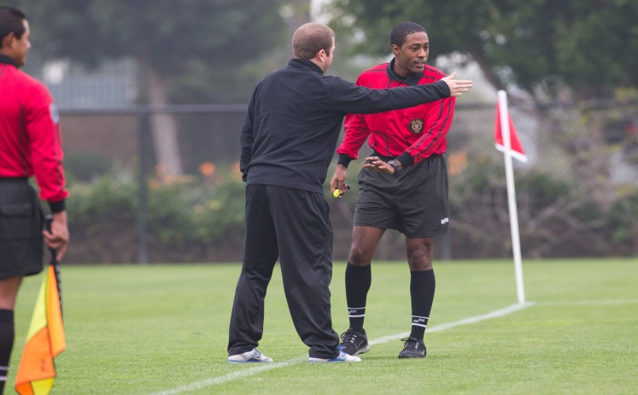
Coaches
Although the Laws of the Game do not permit team officials being shown cards for misconduct, if play is stopped for the purpose of dealing with a coach or other team official who is acting irresponsibly, play is resumed with a dropped ball from the location of the ball when play was stopped.
Local rules of competition as to the displaying of cards to coaches and team officials may be allowed in some instances.

Slide 69
Review Question
74. What should the referee do if a player commits persistent infringement?
  Caution and show the player a yellow card
  Send-off and show the player a red card
  Verbally warn the player

Slide 70
Review Question
75. What should the referee do if a player tackles an opponent using excessive force?
  Caution and show the player a yellow card
  Send-off and show the player a red card

Slide 71
Review Question
76. What should the referee do if an opponent fails to respect the required distance during a throw-in?
  Caution and show the player a yellow card
  Send-off and show the player a red card

Slide 72
Review Question
77. What should the referee do if a player standing in his own penalty area, who has already been cautioned and who is not the goalkeeper, punches the ball away and denies an obvious goal?
Show the player a second yellow card and then issue a red card
Issue a red card

