Slide 1
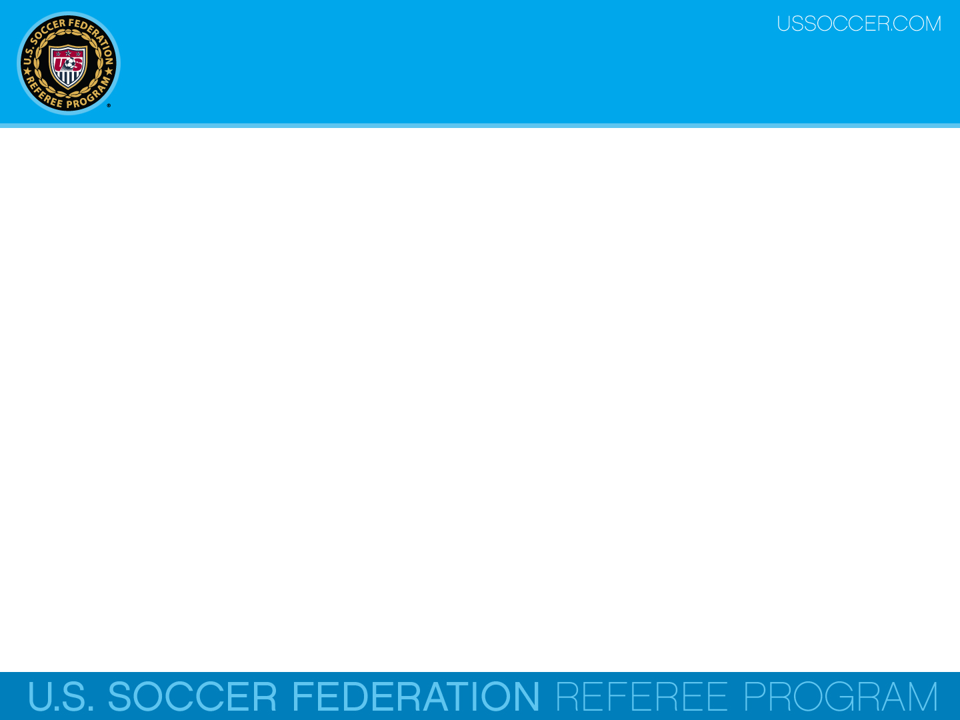

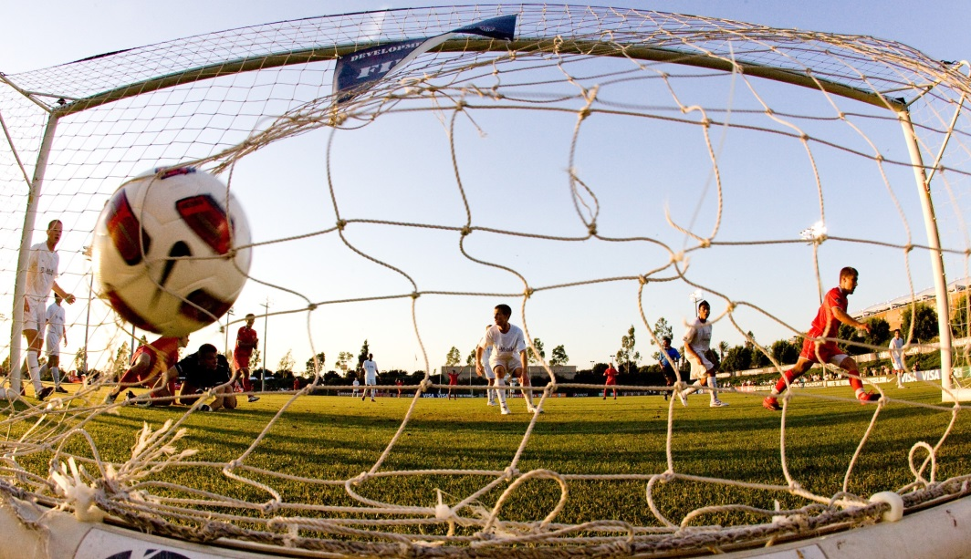
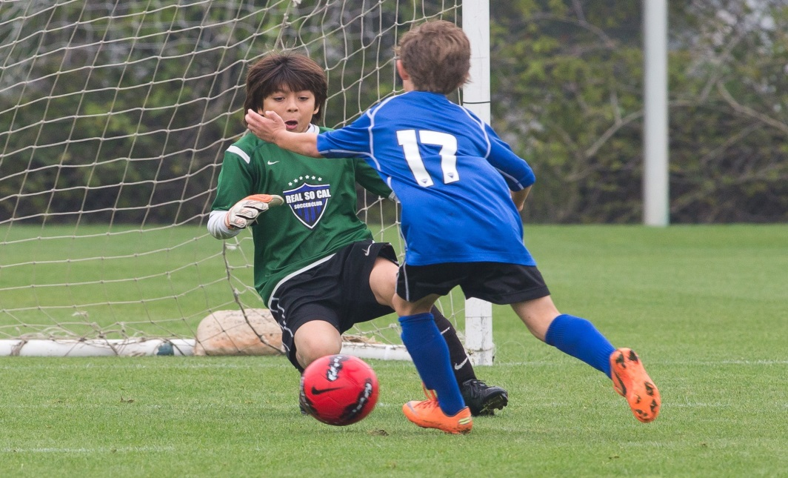
Law 10 – Determining the Outcome
of a Match
U.S. Soccer Federation Referee Program
Entry Level Referee Course
Competitive Youth Training
Small Sided and Recreational Youth Training
2016-17
Notes:
Online Training Script:
Welcome to U.S. Soccer’s online training for the Grade 8 & 9 Referee Course.
Grade 8 training is specific to preparing officials for the competitive youth game.
Grade 9 training is specific to preparing officials for the small sided and recreational youth game.
This presentation focuses on Law 10 – The Method of Scoring.

Slide 2
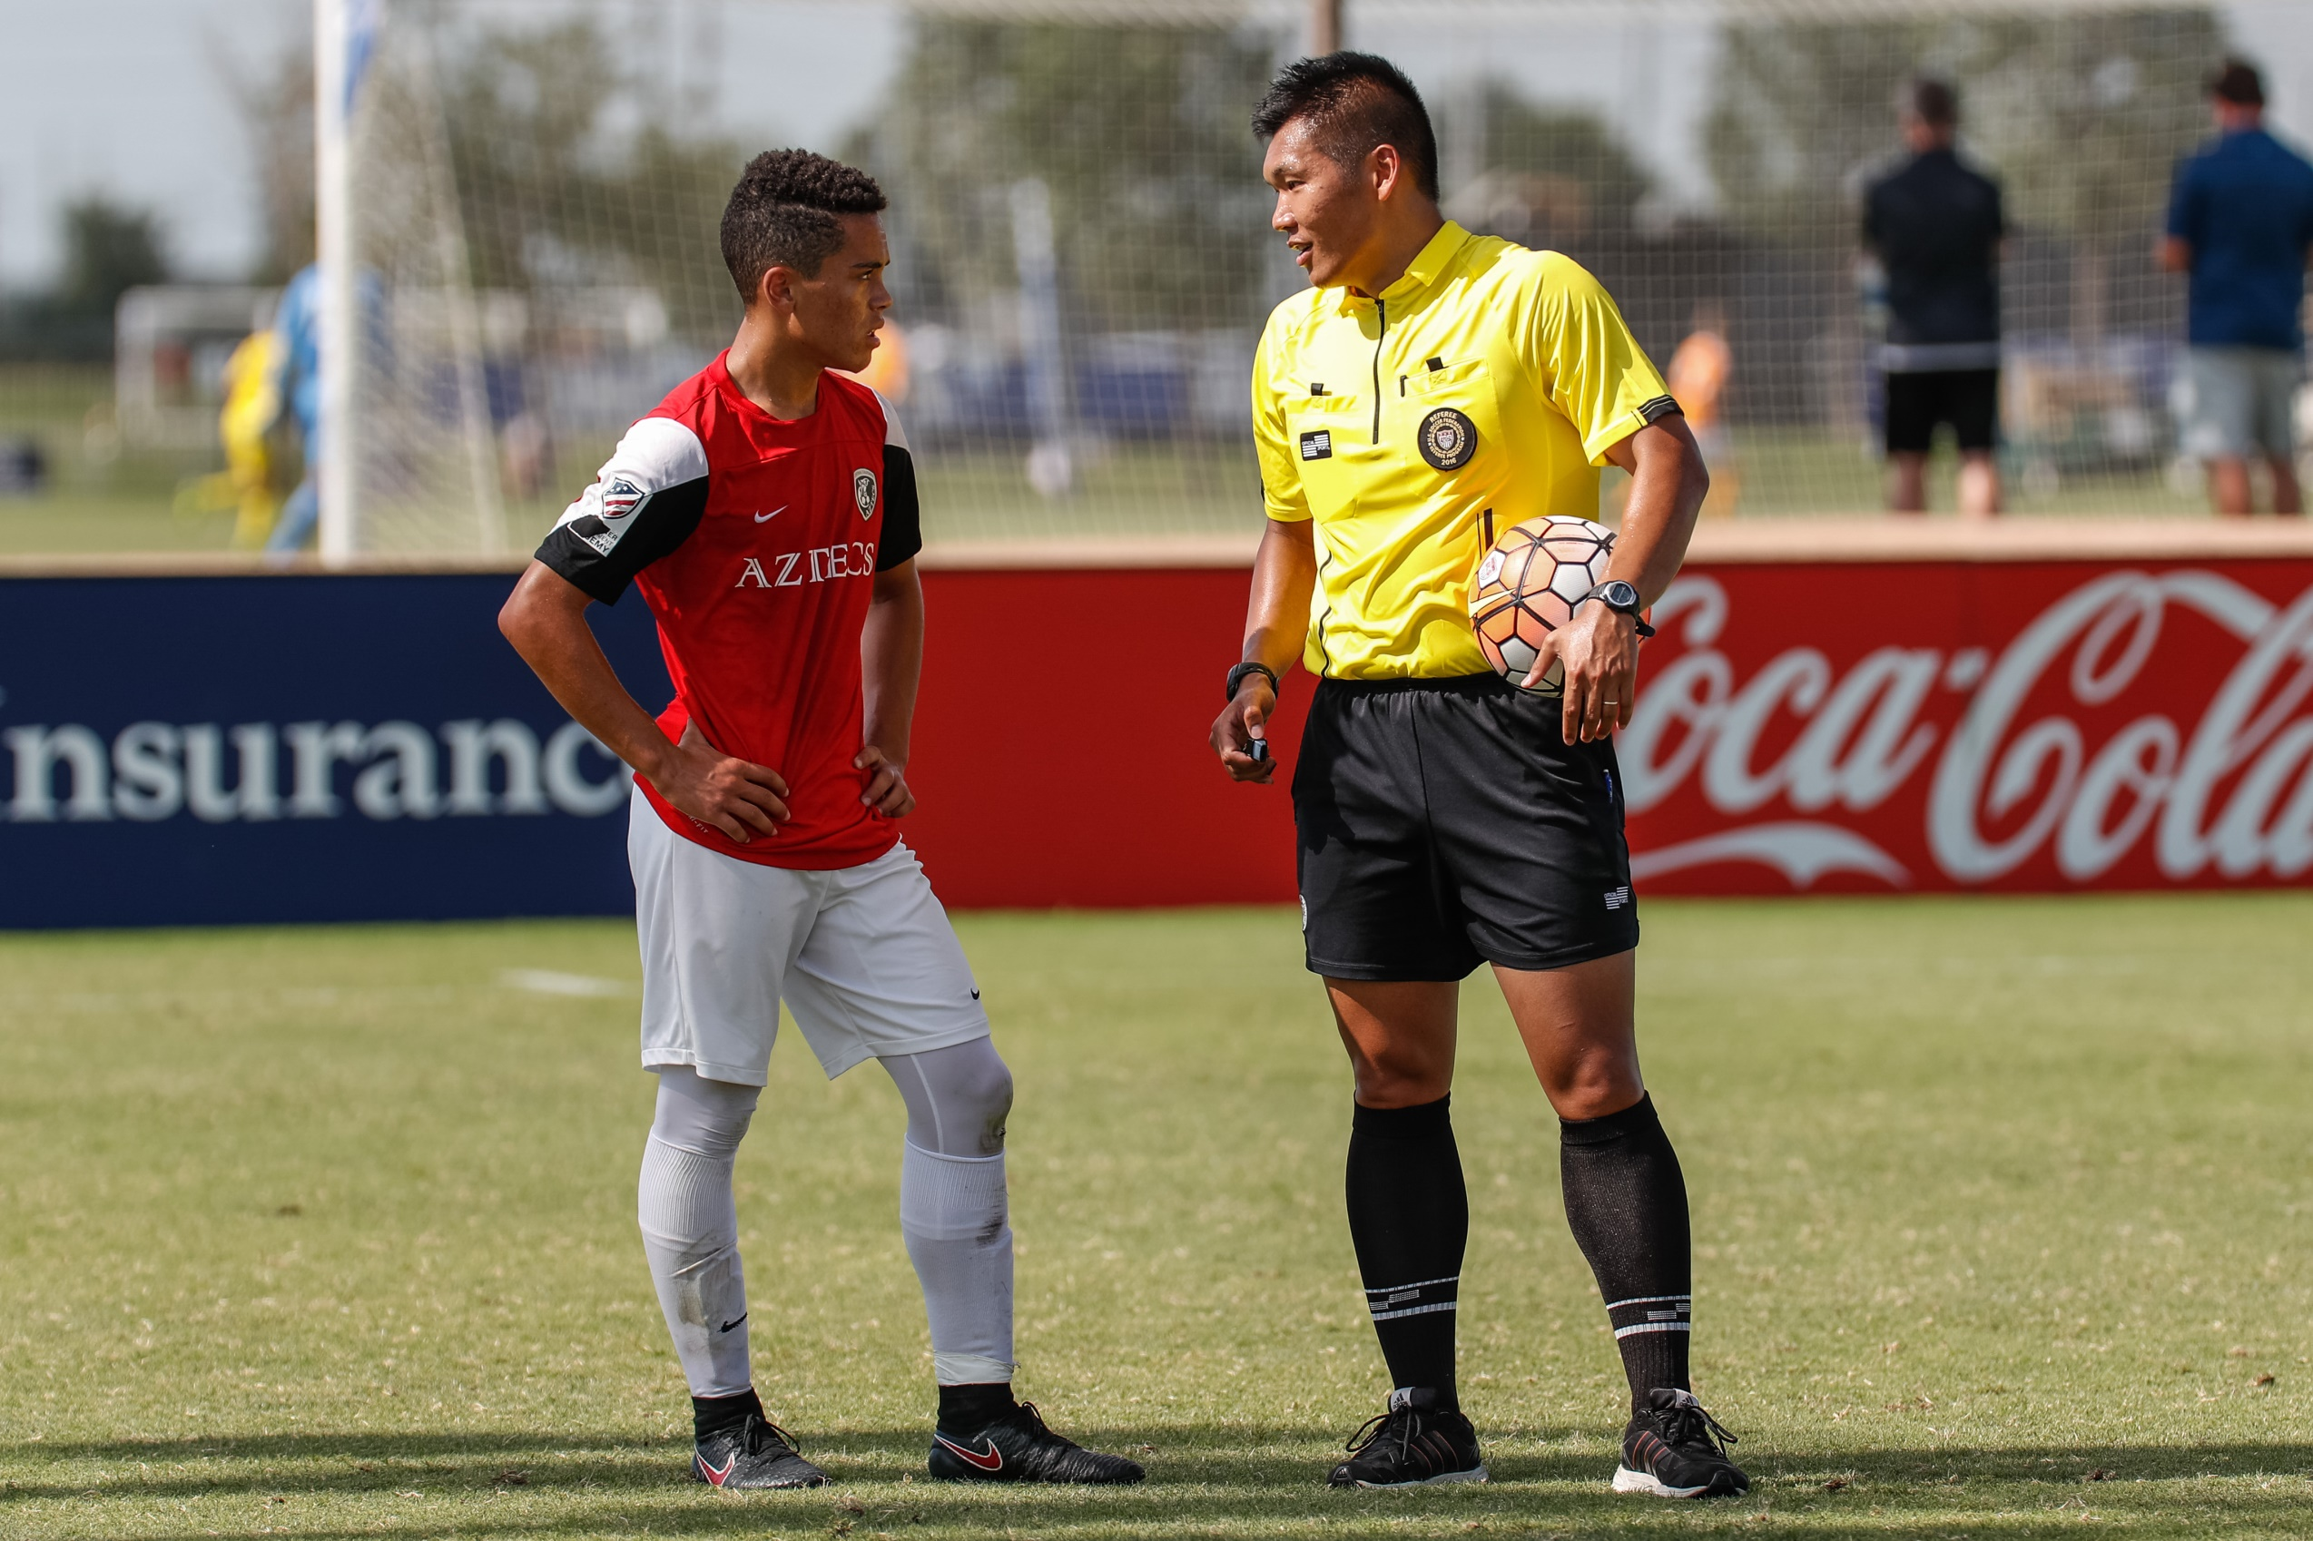
GOAL SCORED
Notes:
Online Training Script:
A goal is scored when the entire ball passes over the goal line, between the goalposts and under the cross bar, provided that no infringement of the Laws of the Game has been committed by the team scoring the goal.
Referees must be confident that a play meets this criteria before awarding a goal.
If a referee signals a goal before the ball has completely passed over the goal line, play is restarted with a dropped ball.
Games at the competitive youth level may require referees and assistant referees to communicate nonverbally and verbally to make sure these criteria have been met.
Classroom Instructor Talking Points:

Slide 3
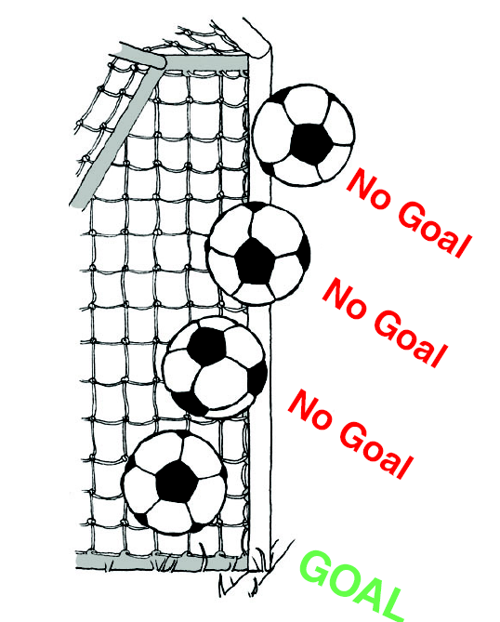
Scoring a Goal
A goal is awarded when the whole ball passes entirely over the goal line, between the goalposts, under the cross bar.

Slide 4
Scoring a Goal
Also, for a goal to count, the attacking team cannot have committed a violation of the Laws of the Game that would cause the goal to be disallowed.

Slide 5
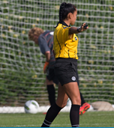
Responsibility
Games at the competitive youth level may require referees and ARs to communicate non-verbally and / or verbally to make sure a ball in the net meets all this criteria before awarding a goal.
If a referee signals a goal before the ball has completely passed over the goal line, play is restarted with a dropped ball.

Slide 6
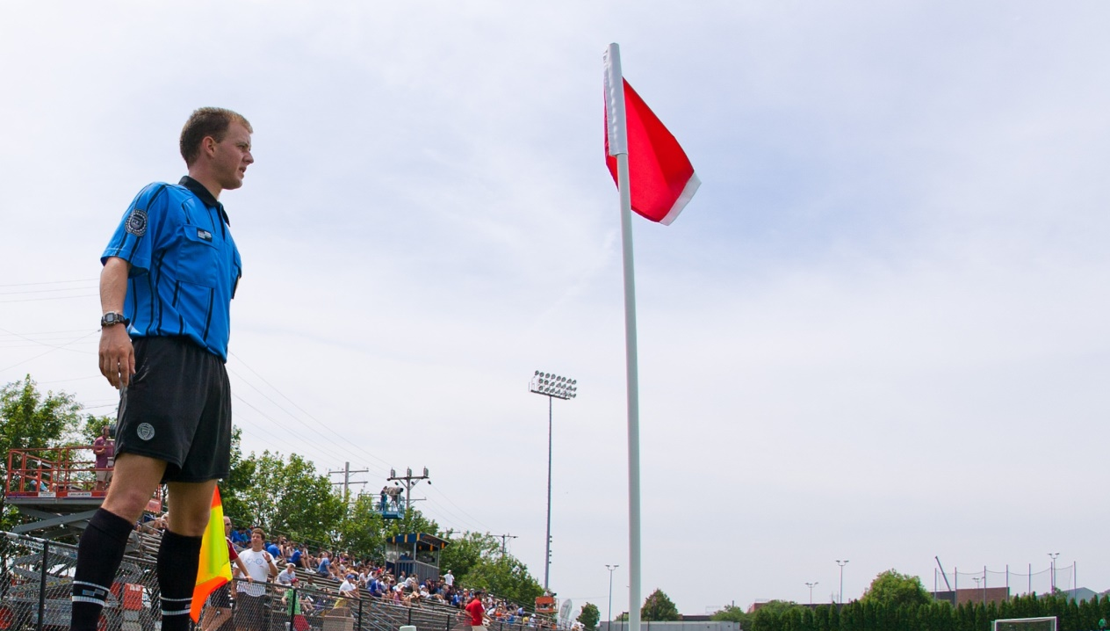
Positioning
The positioning of the AR can be very important in order to determine when a ball has completely crossed the goal line for a goal.

Slide 7

Positioning
An AR has the unique and useful perspective of being able to see in-line with the goal line.
Because of this, ARs need to make sure they are always following play down to the goal line and staying focused on the location of the ball in proximity to the goal line.

Slide 8
Exceptions
However, even if the whole ball passes over the goal line, between the goalposts and under the crossbar, with no infringements committed by the attacking team, there are still exceptions that would result in the goal being disallowed.
While these are not listed in Law 10, there are a number of exceptions of which that referees and ARs must be aware .

Slide 9
Exceptions
The key word in these exceptions that referees must understand is directly.
Directly means on the first touch by the player playing the ball.
A goal cannot be scored directly from any of the restarts listed on the next slide.
  But if another player (on either team) touches or plays the ball, the goal would be valid.

Slide 10
Exceptions
A goal cannot be scored directly (first touch) from any of the following restarts:
  an indirect free kick (IFK),
  any free kick kicked into the kicking team’s own goal,
  a throw-in or
  a dropped ball (first touch).
A team can score against itself but only during the course of play, not directly from a restart.

Slide 11
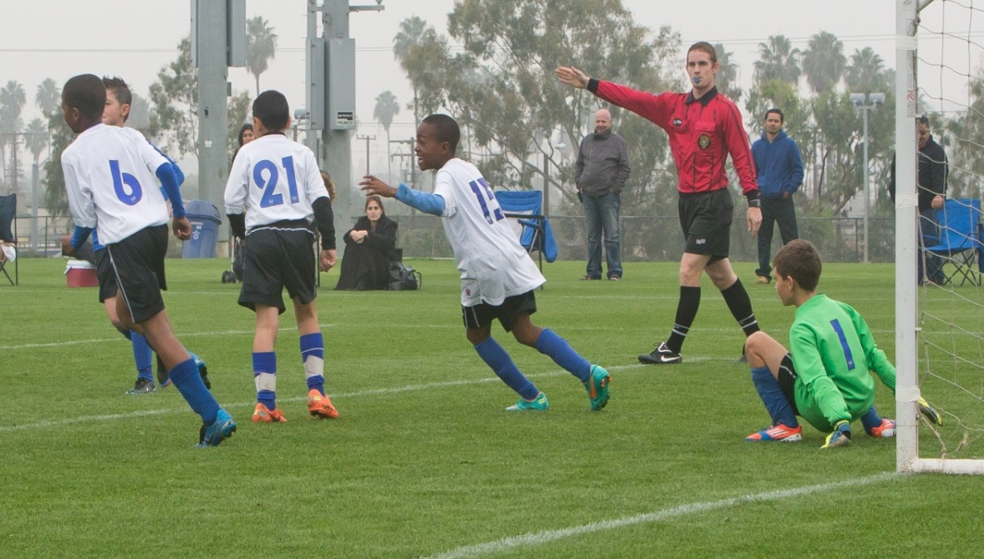
Winning the Game
The team that scores the most goals wins the game.
If both teams score the same number goals, or both score no goals, the game ends in a tie.
The local rules of competition will determine if a tie is allowed.

Slide 12
Review Question
51. Can the referee allow a goal if he or she is unsure if all the criteria for a legal goal have been met?
Yes, so long as the referee is at least 90% sure that the criteria have been met
No, and the referee should communicate with the referee team to make sure the correct decision is made
Notes:
Online Training Script:
Classroom Instructor Talking Points:

Slide 13
Review Question
52. What must happen for a legal goal to be scored?
    The ball must completely cross the goal line, between the goalposts and under the crossbar
    The ball must make contact with the goal net
    The ball must completely cross the plane of the goal frame (i.e. goalposts and crossbar)

