Slide 1
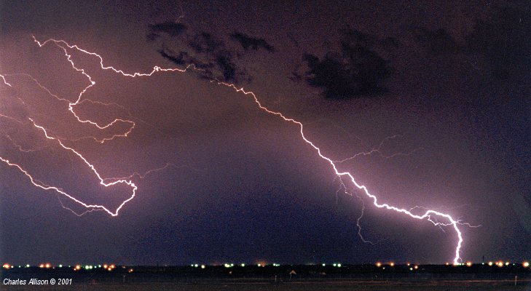
Lightning Safety
Ohio South 2016
Intermediate Referee Recertification Training

Slide 5
Brain Teaser #1

