Slide 1
Offside: Involvement in Play
Ohio South Referee Training
2015 Grade 8
Referee Recertification

Slide 2
Offside Offense Step-by-Step
1 …. WHO? …. Attacking Player
2 …. WHERE? …. In an Offside Position
3 …. WHEN? …. At Time the Ball is Played or Touched by a Teammate
4 …. HOW? …. By Becoming Actively Involved in Play
The Offside Offense is more than just “touching the ball”

Slide 3
Offside: The Offence
requires….
Position + Involvement
Offside Position means an attacker is….
in their opponent’s half of field … AND
closer to the goal line then the second to last defender … AND
closer to the goal line than the ball

Slide 4
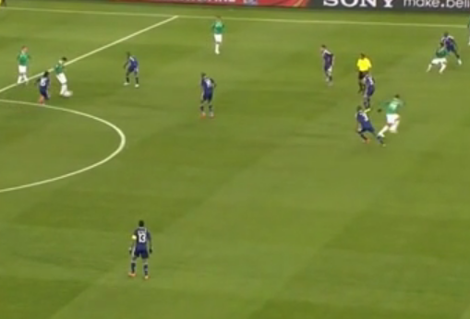
Offside or
Not Offside
Position?

Slide 5
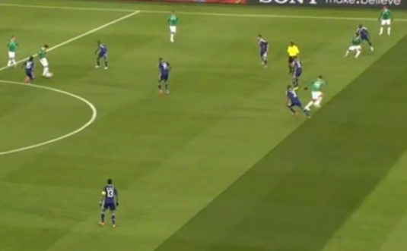
Do NOT judge position using attacker’s “upper body” vs. defender’s “upper body”

Slide 6
Judge attacker’s leading body part that can legally play the ball vs. defender’s most trailing body part (foot)

Slide 7
Still in Onside Position

Slide 8
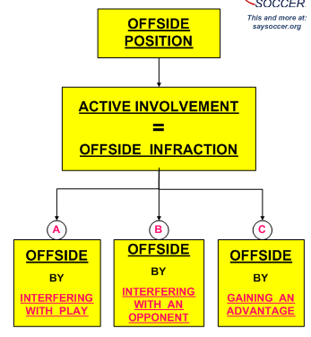
Offside: The Offence
requires….
Position + Involvement

Slide 9
Offside:
A. Interfering with Play means….
“touching” the ball (intentional or not) last played or touched by a teammate.

Slide 10
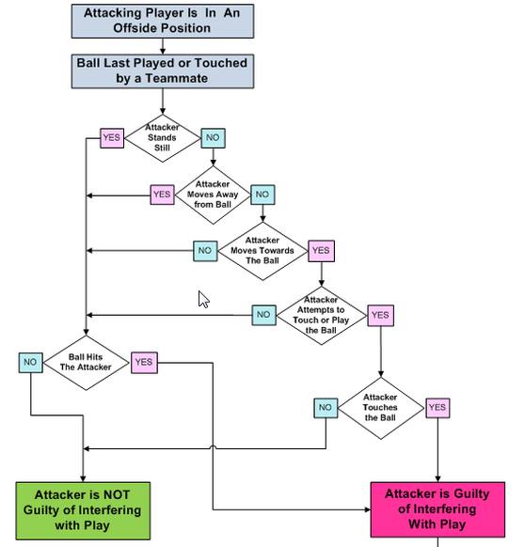
Interfering with Play
MUST “Touch” the ball

Slide 11
Offside:
B. Interfering with an Opponent means….
Blocking the movement or vision of an opponent
OR
Making a movement which causes an opponent to move or react accordingly.

Slide 12
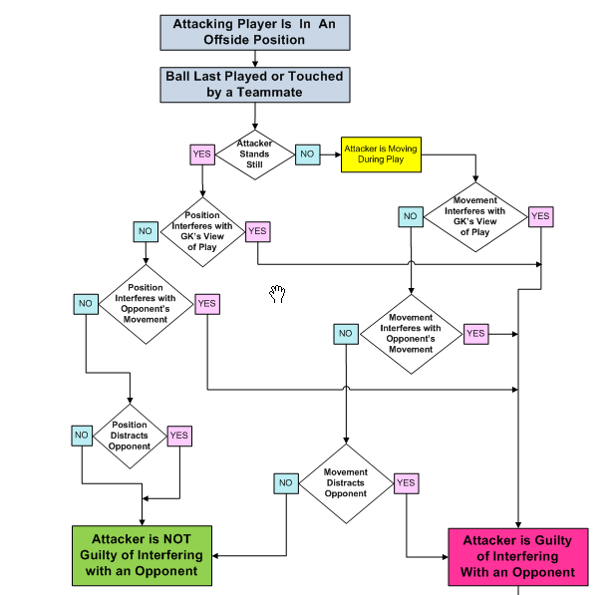
Interfering with an Opponent
No “Touch” of the ball
required

Slide 13
Offside:
C. Gaining an Advantage means….
playing or touching a ball that rebounds or deflects
off a goal post or the crossbar ….. OR …..
off an opponent

Slide 14
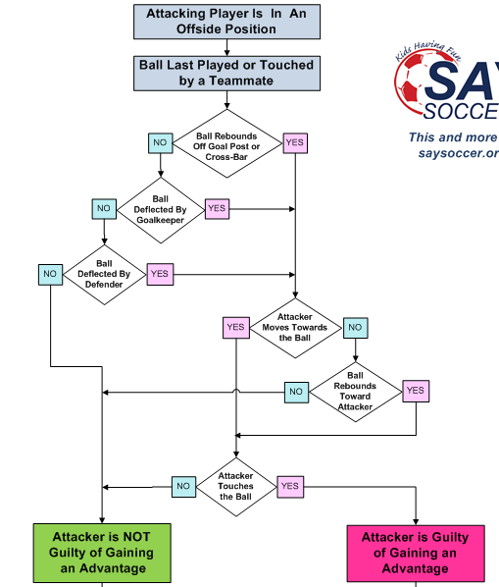
Gaining
an
Advantage
MUST “Touch” the ball

Slide 15
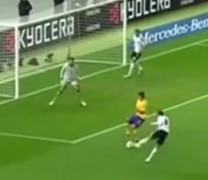
Offside or
Not Offside?

Slide 16
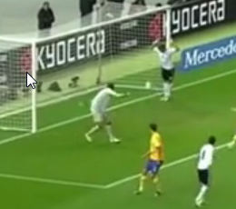
Did he touch
the ball?

Slide 17
Did he interfere
with an opponent?

Slide 18
Was there a deflection or rebound?

Slide 19
NOT OFFSIDE !!

Slide 20
Offside Review
Interference with Play or Gaining an Advantage requires actual contact with the ball.
“Touching the ball” is not required for calling offside if the attacker in an offside position is Interfering with an Opponent by blocking the keeper’s view of the ball, blocking a defender from playing the ball or making a movement or gesture which, in the opinion of the referee, causes that opponent to react and move.

Slide 21
OFFSIDE - Brain Teaser
A player A9 in an offside position sprints towards the ball that has been kicked ahead by a teammate.
The nearest defender, D5, then also starts to sprint to the ball, but well before either player is able to touch it, the ball passes over the goal line and out of play.
Should the AR signal for the offside offense?
A. Yes
B. No

Slide 22
OFFSIDE – Brain Teaser
A player A12 in an offside position sprints towards the ball that has been kicked ahead by a teammate.
The nearest defender, D4, then also starts to sprint to the ball, and is able to kick the ball over the goal line and out of play just before A12 is able to reach the ball.
Should the AR signal for the offside offense?
A. Yes
B. No

