Slide 1
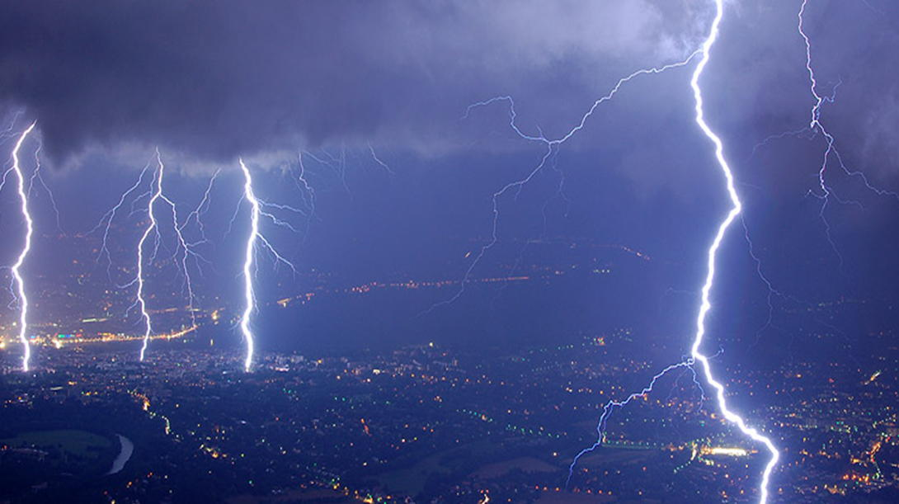
Lightning Safety
2015 Grade 8
Referee Recertification

Slide 2
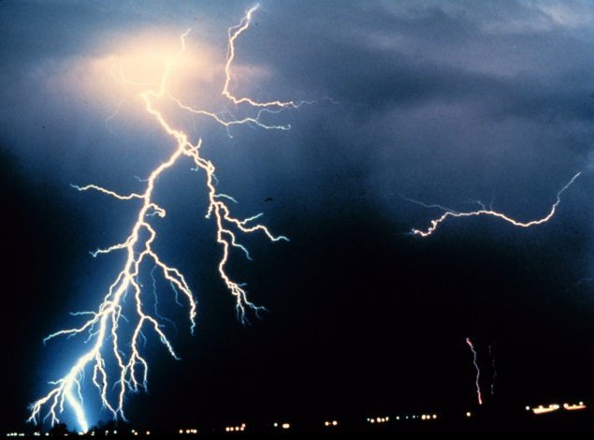
OSSRC Lightning Policy
If any of the 3 things below happens, the referee should immediately suspend the game.
If thunder is heard
If lightning is seen
If lightning detector is sounded

Slide 3
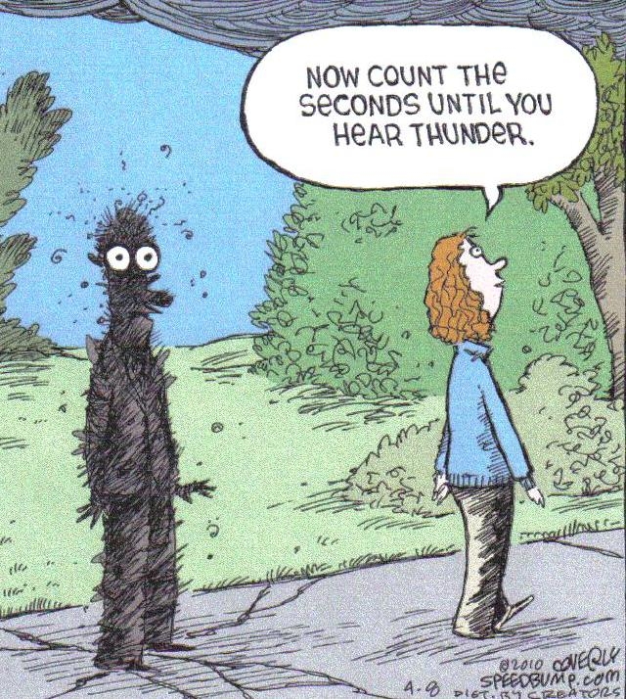

Slide 4
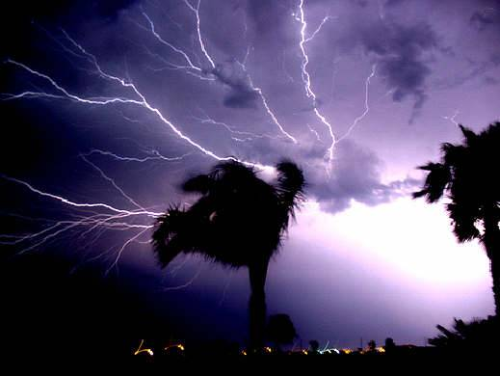
Lightning Detectors
Use as a compliment to your eyes and ears.
If you see lightning or hear thunder, do not wait for the detector to sound.
Remember, they are not thunder detectors!!
Lightning Detectors

Slide 5
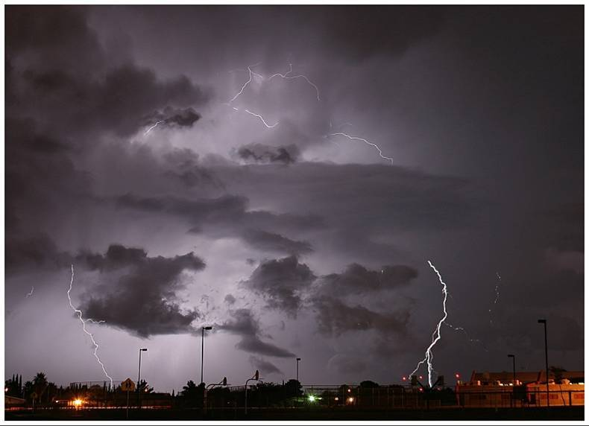
Lightning Policy Protocol
Whatever Occurs FIRST:
If a Lightning Detector Sounds
Stop the game immediately
If you see lightning of any sort
Stop the game immediately
If you hear thunder, even in the distance
Stop the game immediately
DO NOT WAIT to see or hear a second signal to confirm.
Lightning Detectors
Lightning Detectors

Slide 6
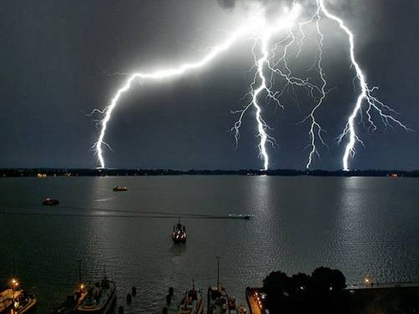
REMEMBER !!
DO NOT WAIT!!
STOP IMMEDIATELY!!
NO game is that important !!

Slide 7
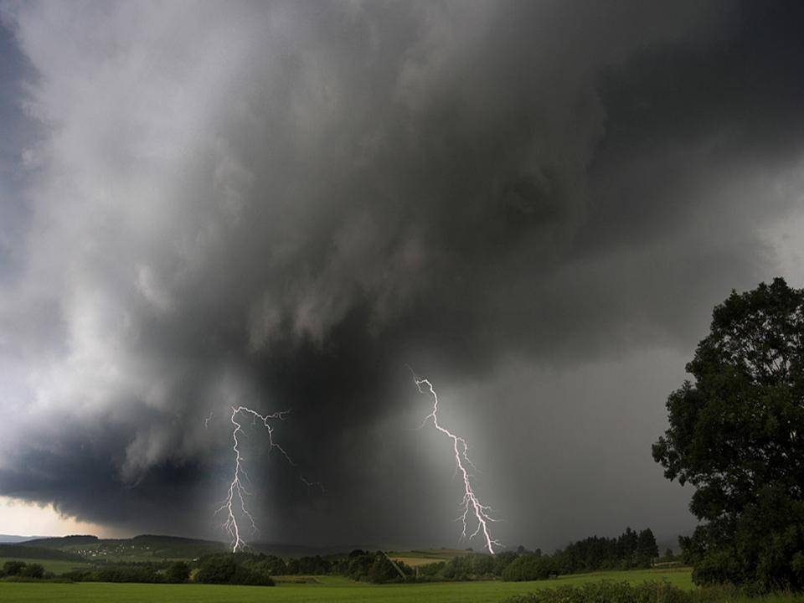
WHAT TO DO ??
OSSRC Lightning Policy
No one should retake the field for a minimum of 30 minutes after the last lightning is seen or thunder is heard.
The 30 minutes is restarted every time lightning is seen or thunder is heard !!

Slide 8
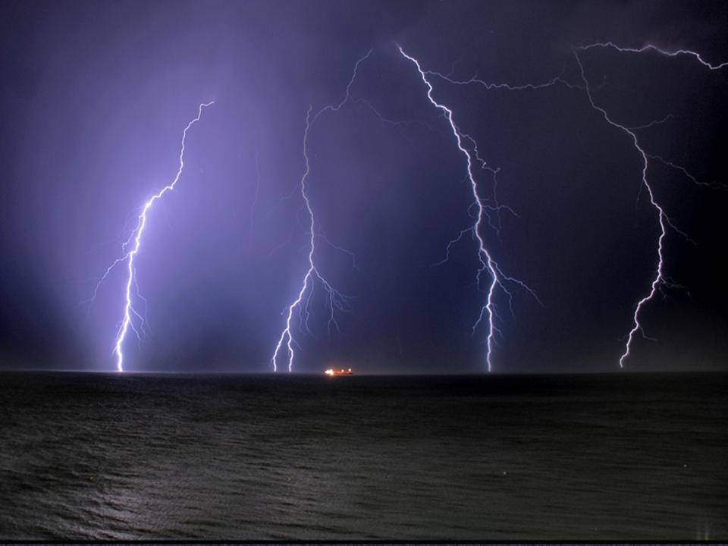
Lightning Policy Protocol
Returning to the Field and Resuming Play:
WAIT until the Lightning Detector Sounds All Clear ….. OR
WAIT at least 30 minutes after observing the last lightning of any sort …. OR
WAIT at least 30 minutes after the last sound of thunder, even in the distance.
WHICHEVER OCCURS LAST!!!
Lightning Detectors
Lightning Detectors

Slide 9
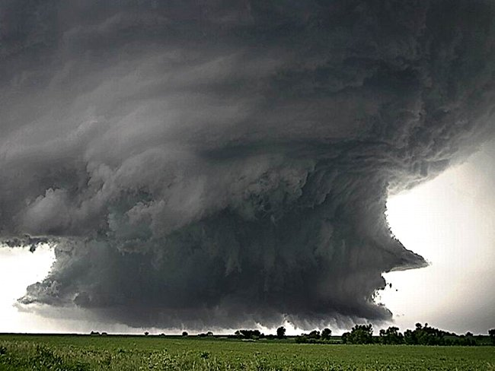
Choose a Caption
I don’t think the heavy stuff is coming down for a while.
No lightning and no thunder! Why can’t we play?
We have time to finish the game!
“Play On” !!

Slide 10
LIGHTNING - Brain Teaser
You are refereeing a game. Midway through the second half, the sky gets cloudy with angry, dark gray clouds and you hear distant thunder. You stop the game.
After 10 minutes, it is still cloudy but no further sounds of thunder were heard.
The coach of the Red team sends his players back out onto the field to restart play. The other team does the same.
As the Referee, you must go out onto the field and restart the match.
A. TRUE B. FALSE

